Slide 1
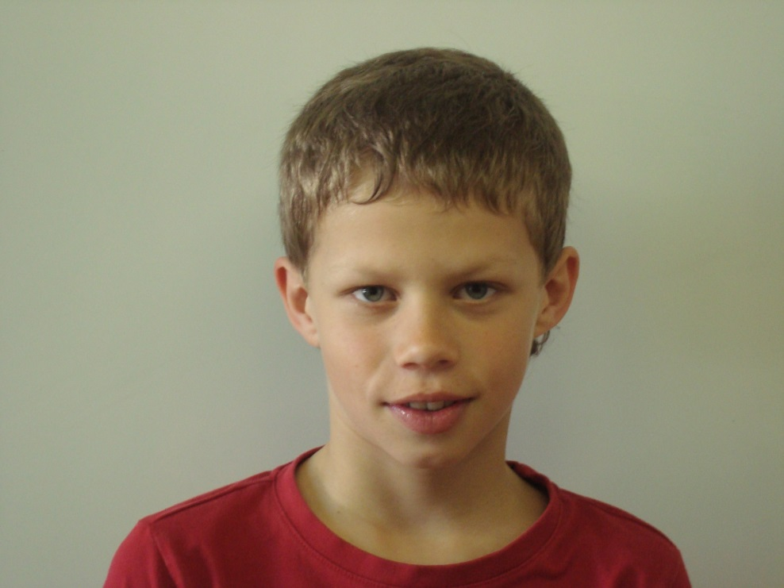
My name is Richard Částek. I am ten years old.

Slide 2
I live in Vranovská Ves. I have got two brothers. Their names are Martin and Ondřej. My father´s name is Igor. He works as a repairman. My mother´s name is Michaela. She is at home.

Slide 3
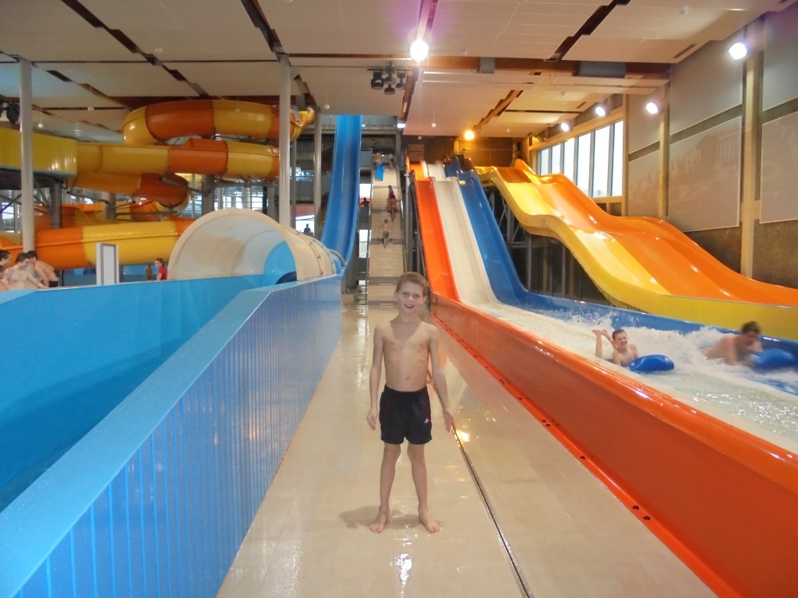
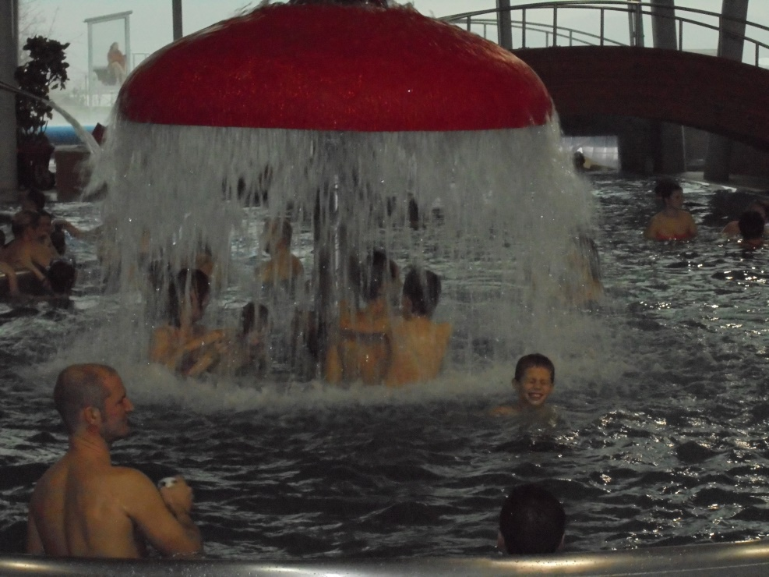
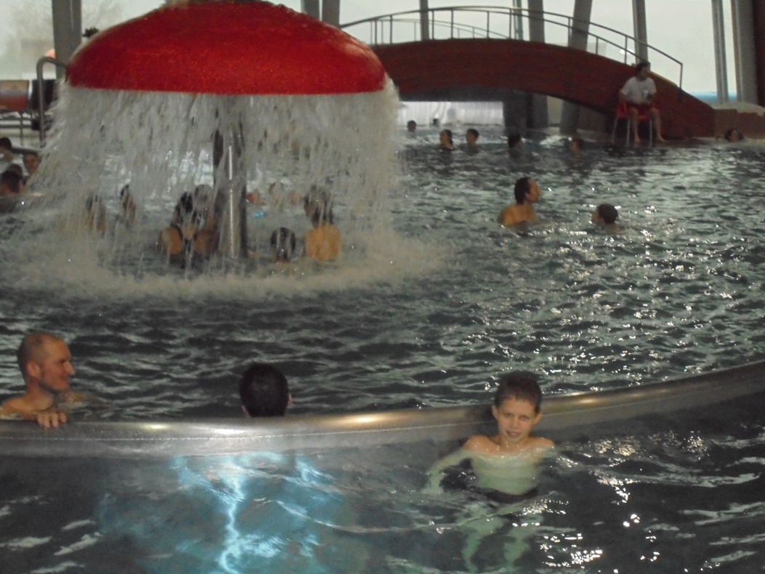
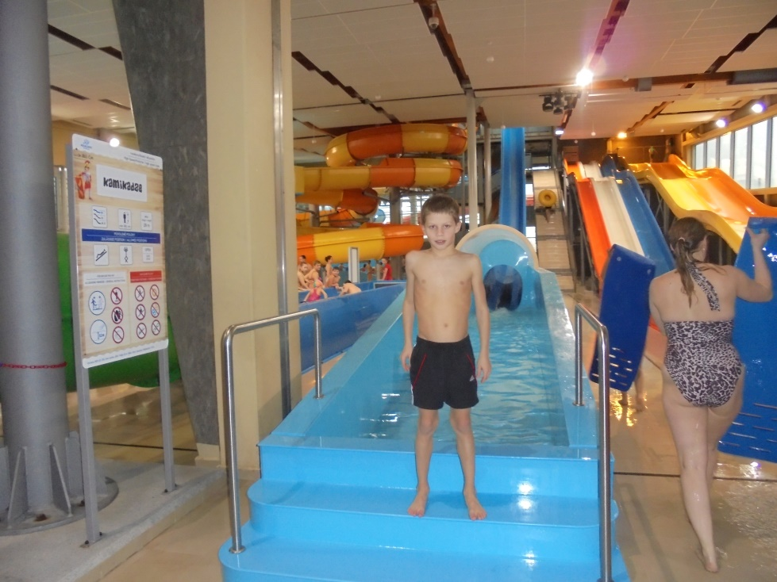
I´m in Aqualand Moravia in Pasohlávky.

Slide 4
I go to school in Pavlice. I go to fourth classroom. In the school my the most favourite subject is physical education. I play ice hockey in Znojmo. I like chips and chicken cutlet. I have got guinea pig and rabbit. I like riding a scooter.

Slide 5
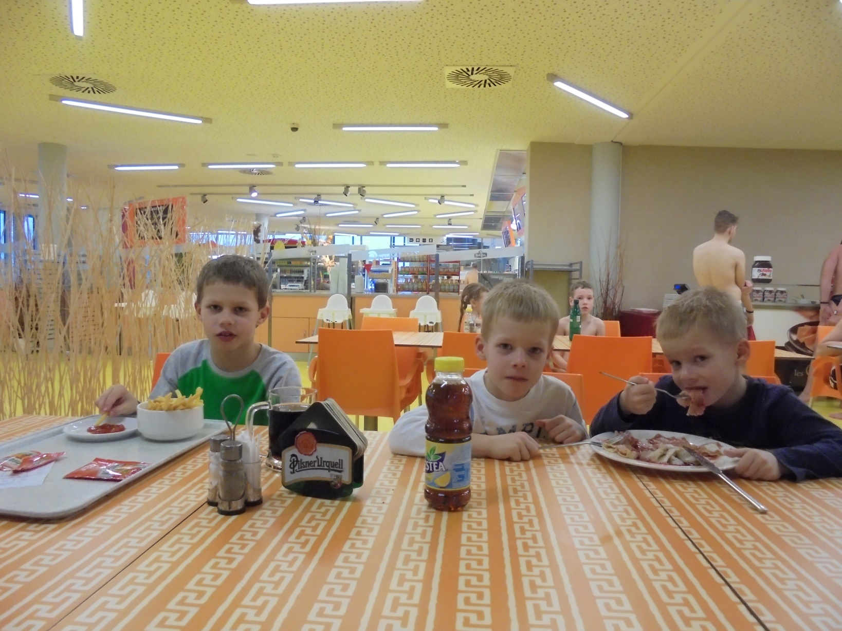
I have lunch with my brothers in Aqualand Moravia.

Slide 6
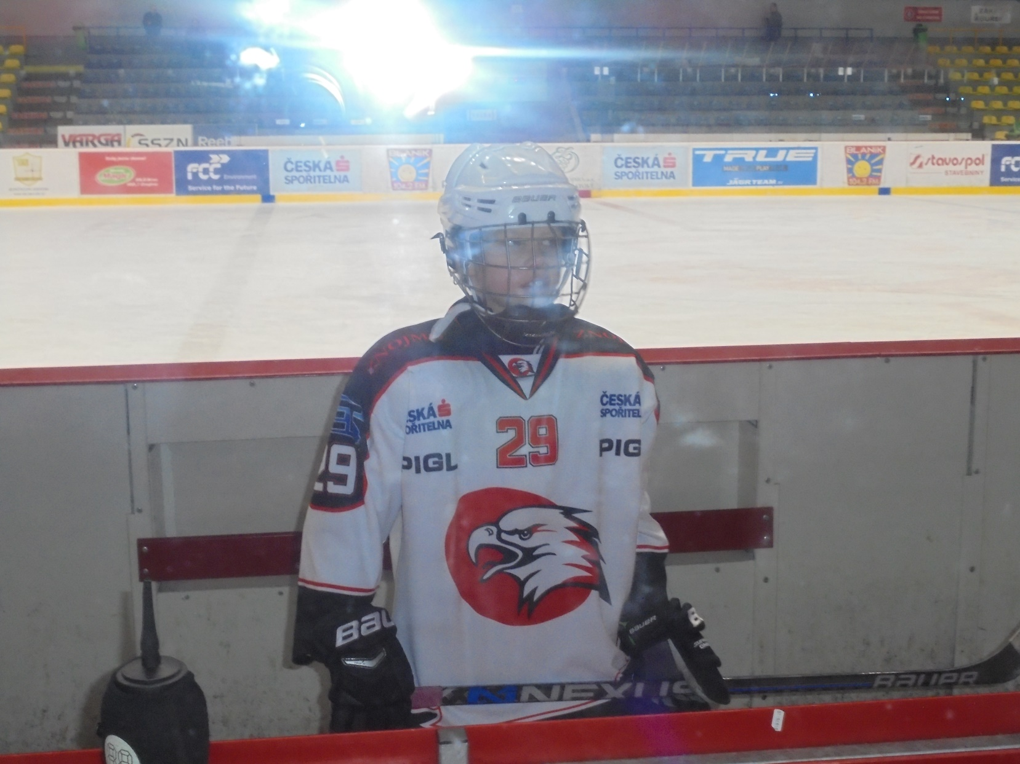
I play ice hockey in winter stadium in Znojmo.

Slide 7
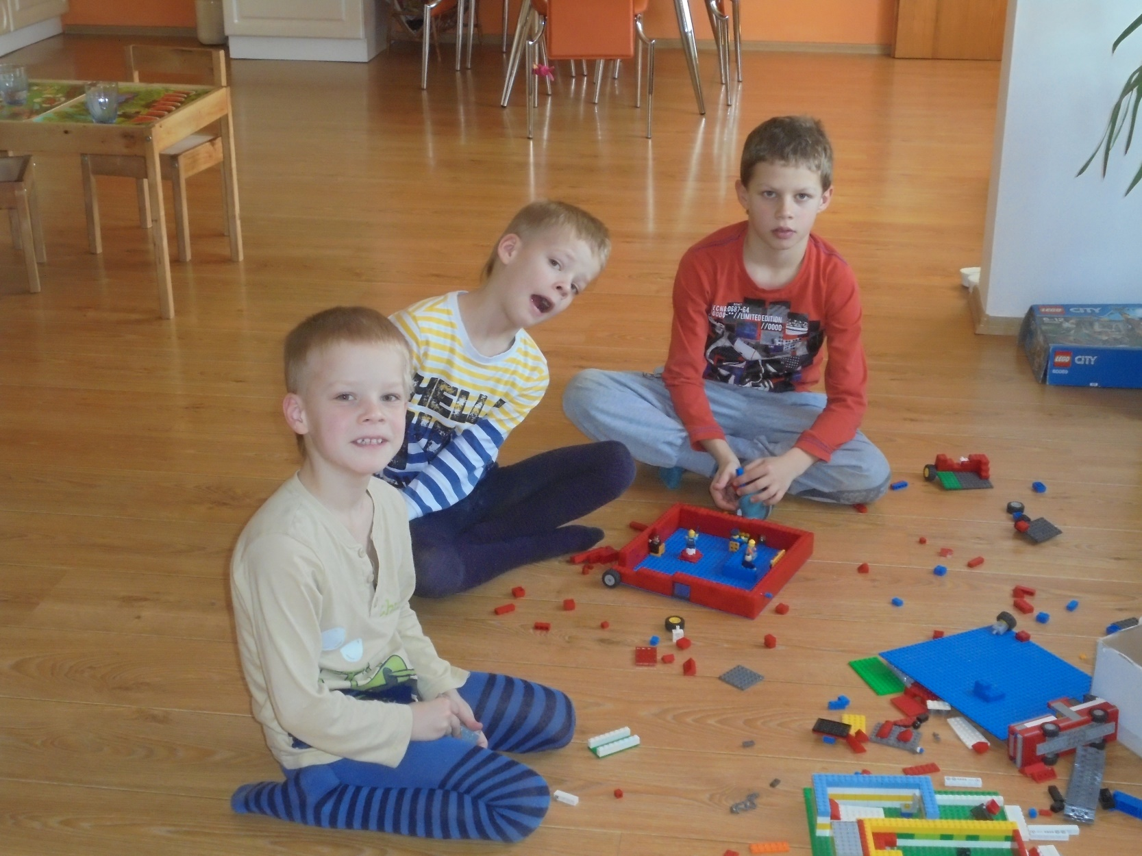
I play with my brothers with lego at home.

