Slide 1
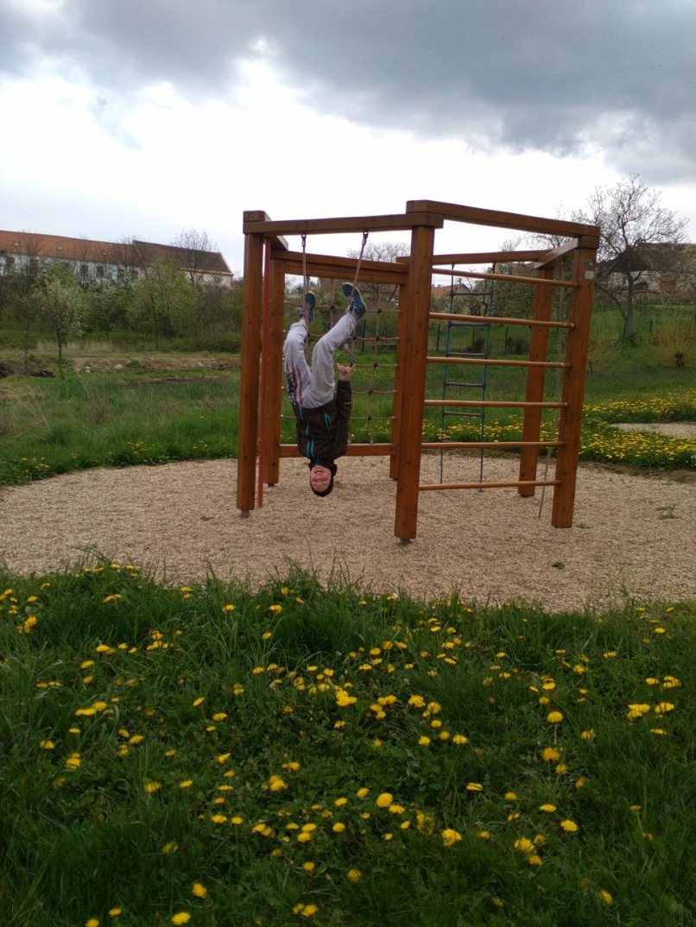
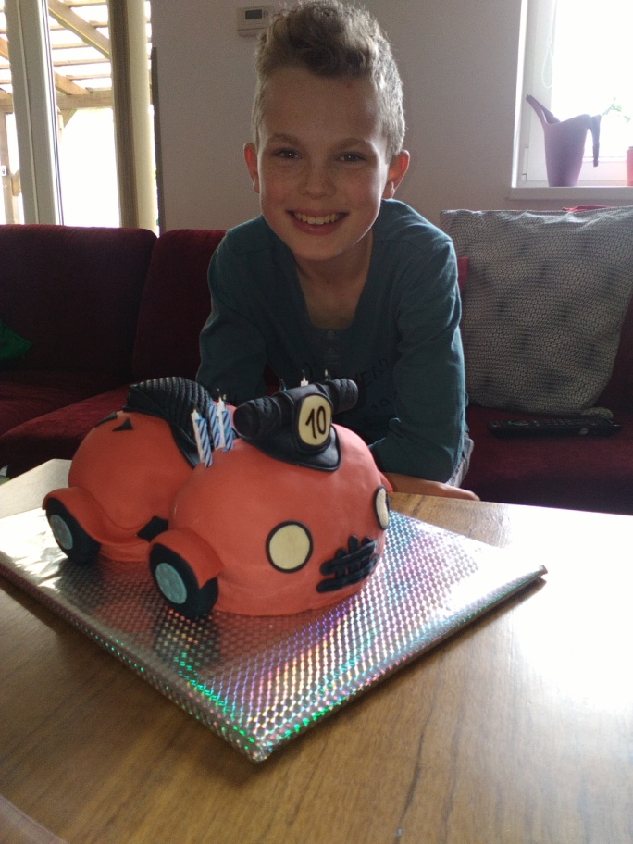
My name is Pepa Myslík. I live in Pavlice with my family. I‘m ten years old . I have got one sister, her name is Amálka. I have got dog and cat. Dog´s name is Ťapka and cat´s name is Míca. I can ride the scooter.

Slide 2
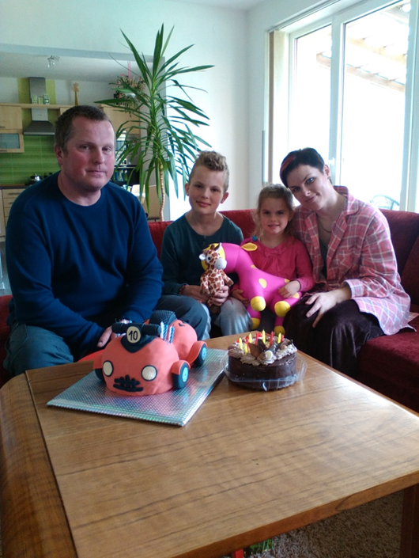
This is my family
My mother‘s name is Zuzana. She‘s 35 years old. She‘s got brown short hair. She‘s got a brown and green eyes.
My father‘s name is Josef. He is 36 years old. He‘s got short brown hair. He‘s got brown and green eyes.

Slide 3
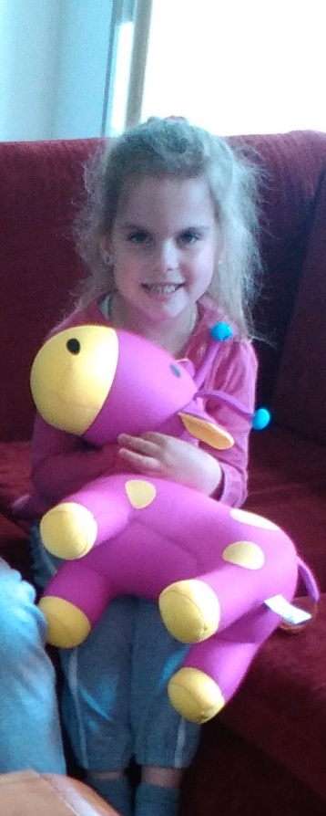
My sister
My sister‘s name is Amálka. She‘s 4 years old. She has got a long brown hair. She has got brown and green eyes.

Slide 4
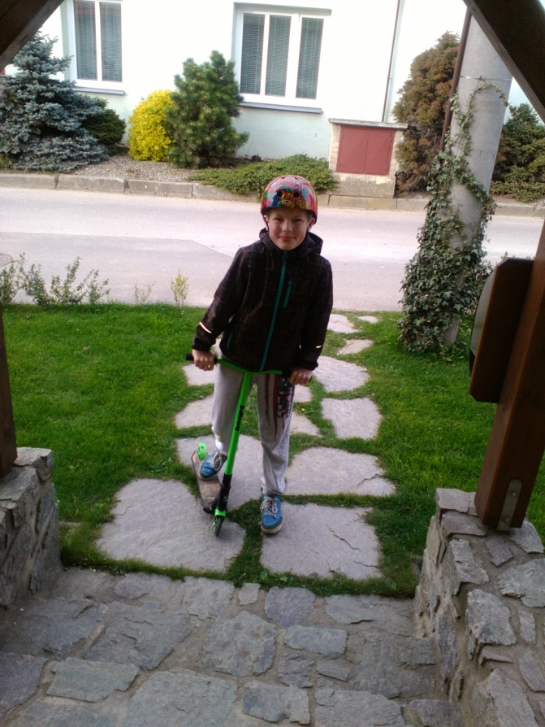
I ride the scooter

Slide 5
I like riding a bike.

Slide 6
BYE BYE

