Slide 1
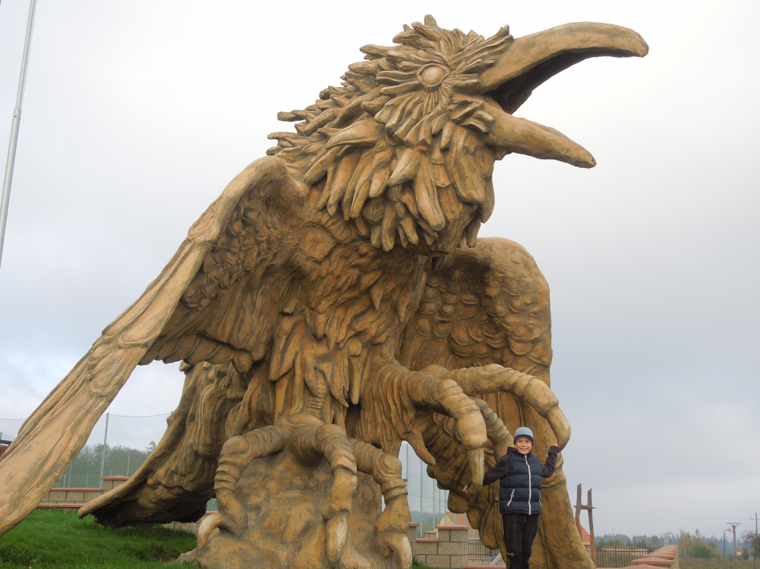
JONÁŠ PETŘÍČEK

Slide 2
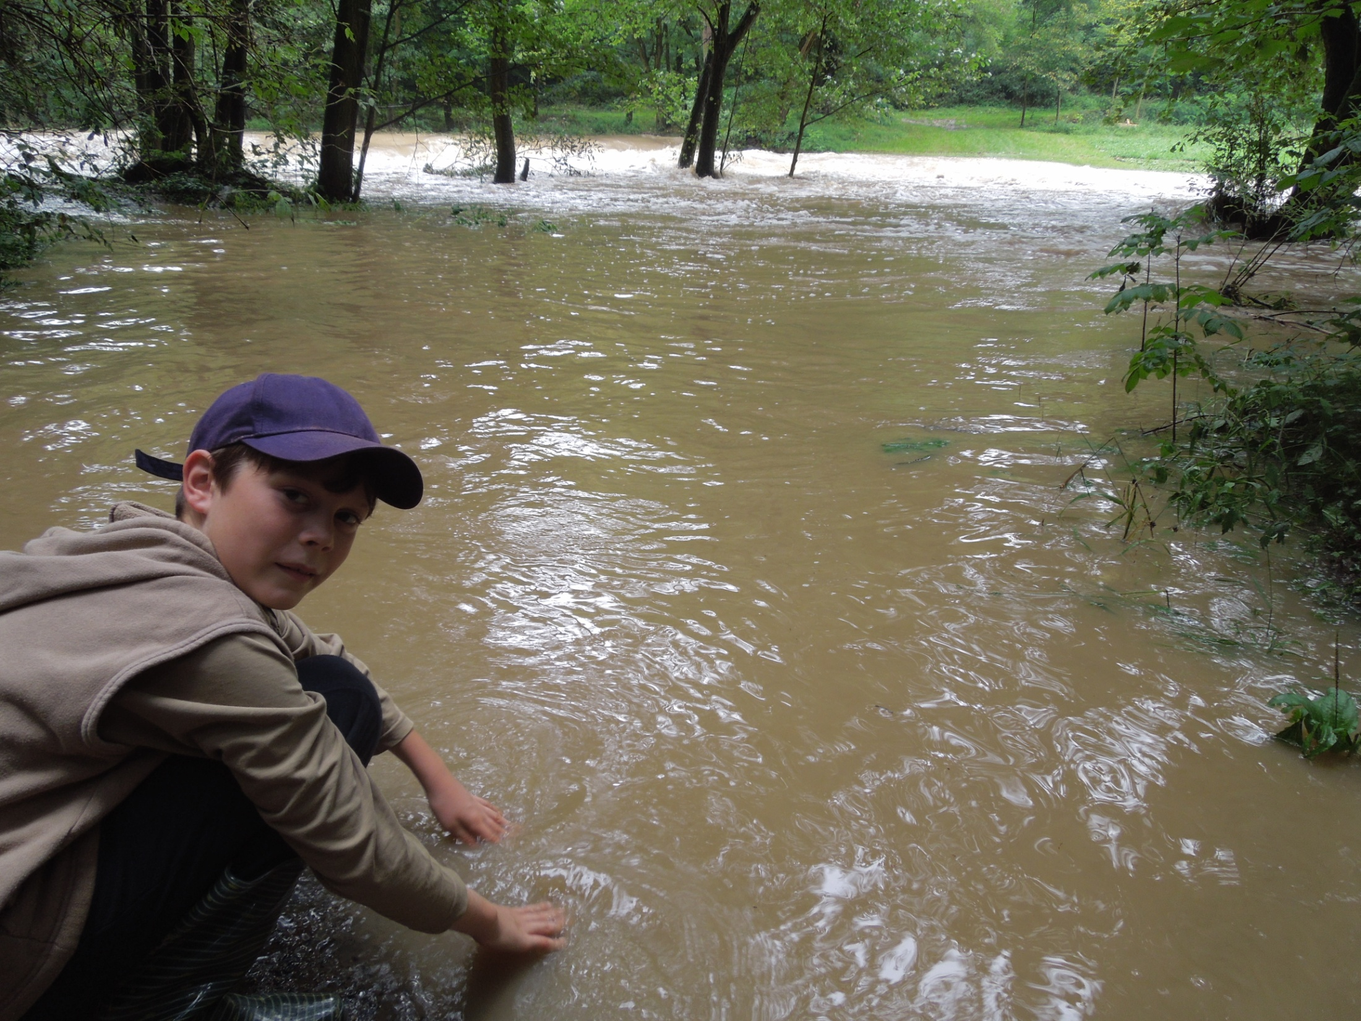
ME
My name is Jonáš.
I‘m 11.
I have short dark brown hair.
I have brown eyes.
My favourite colours are green,black and white

Slide 3
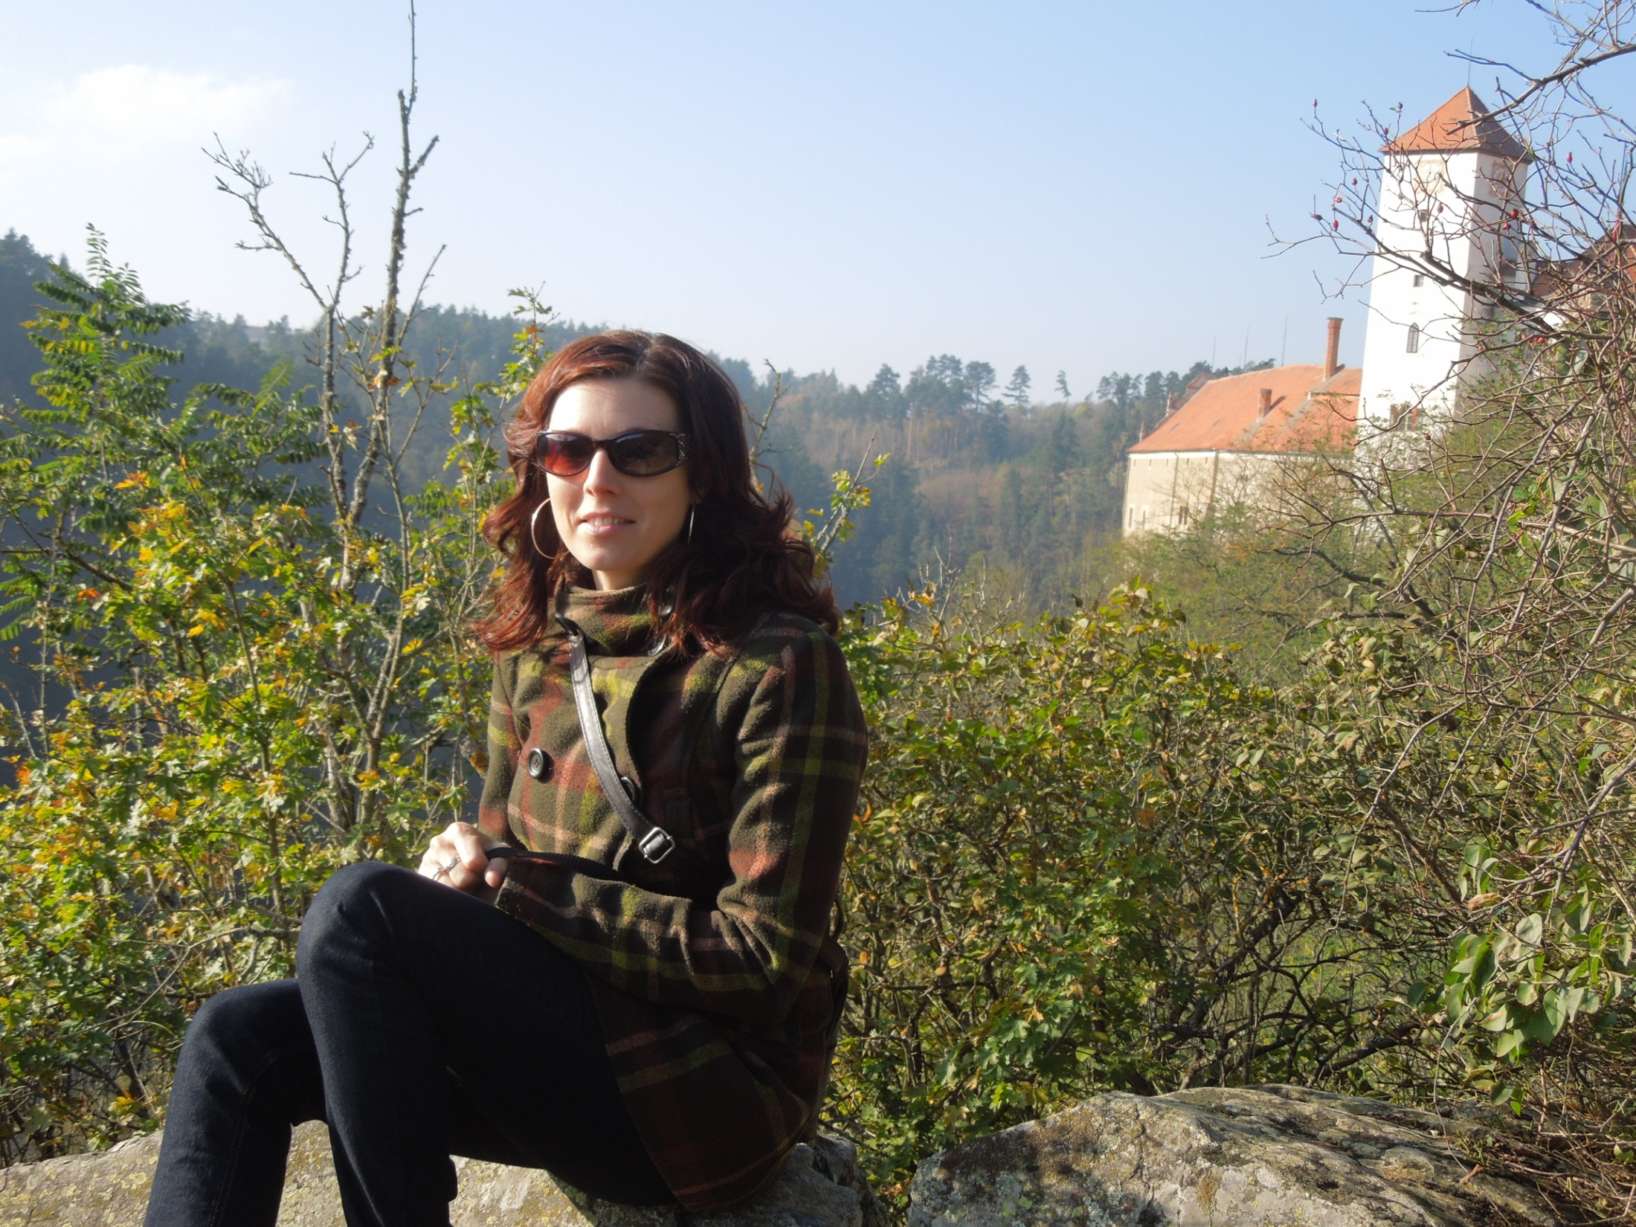
MY MOTHER
She is 38.
Her name is Tereza.
She is a social worker.
She has got green eyes and long brown hair.
She is midlle tall.
Her favourite colours are purple and green.

Slide 4
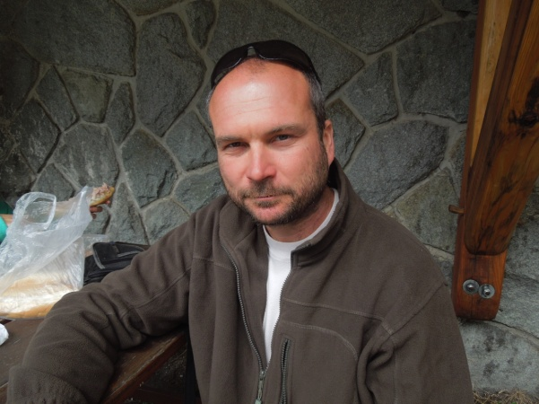
MY FATHER
His name is Rudolf.
He is 41 years old.
He is farmer.
His favourite colour is green.
He is tall. He has got grey eyes, short black hair, short black beard.
His hobby is hunting, he is gamekeeper.

Slide 5
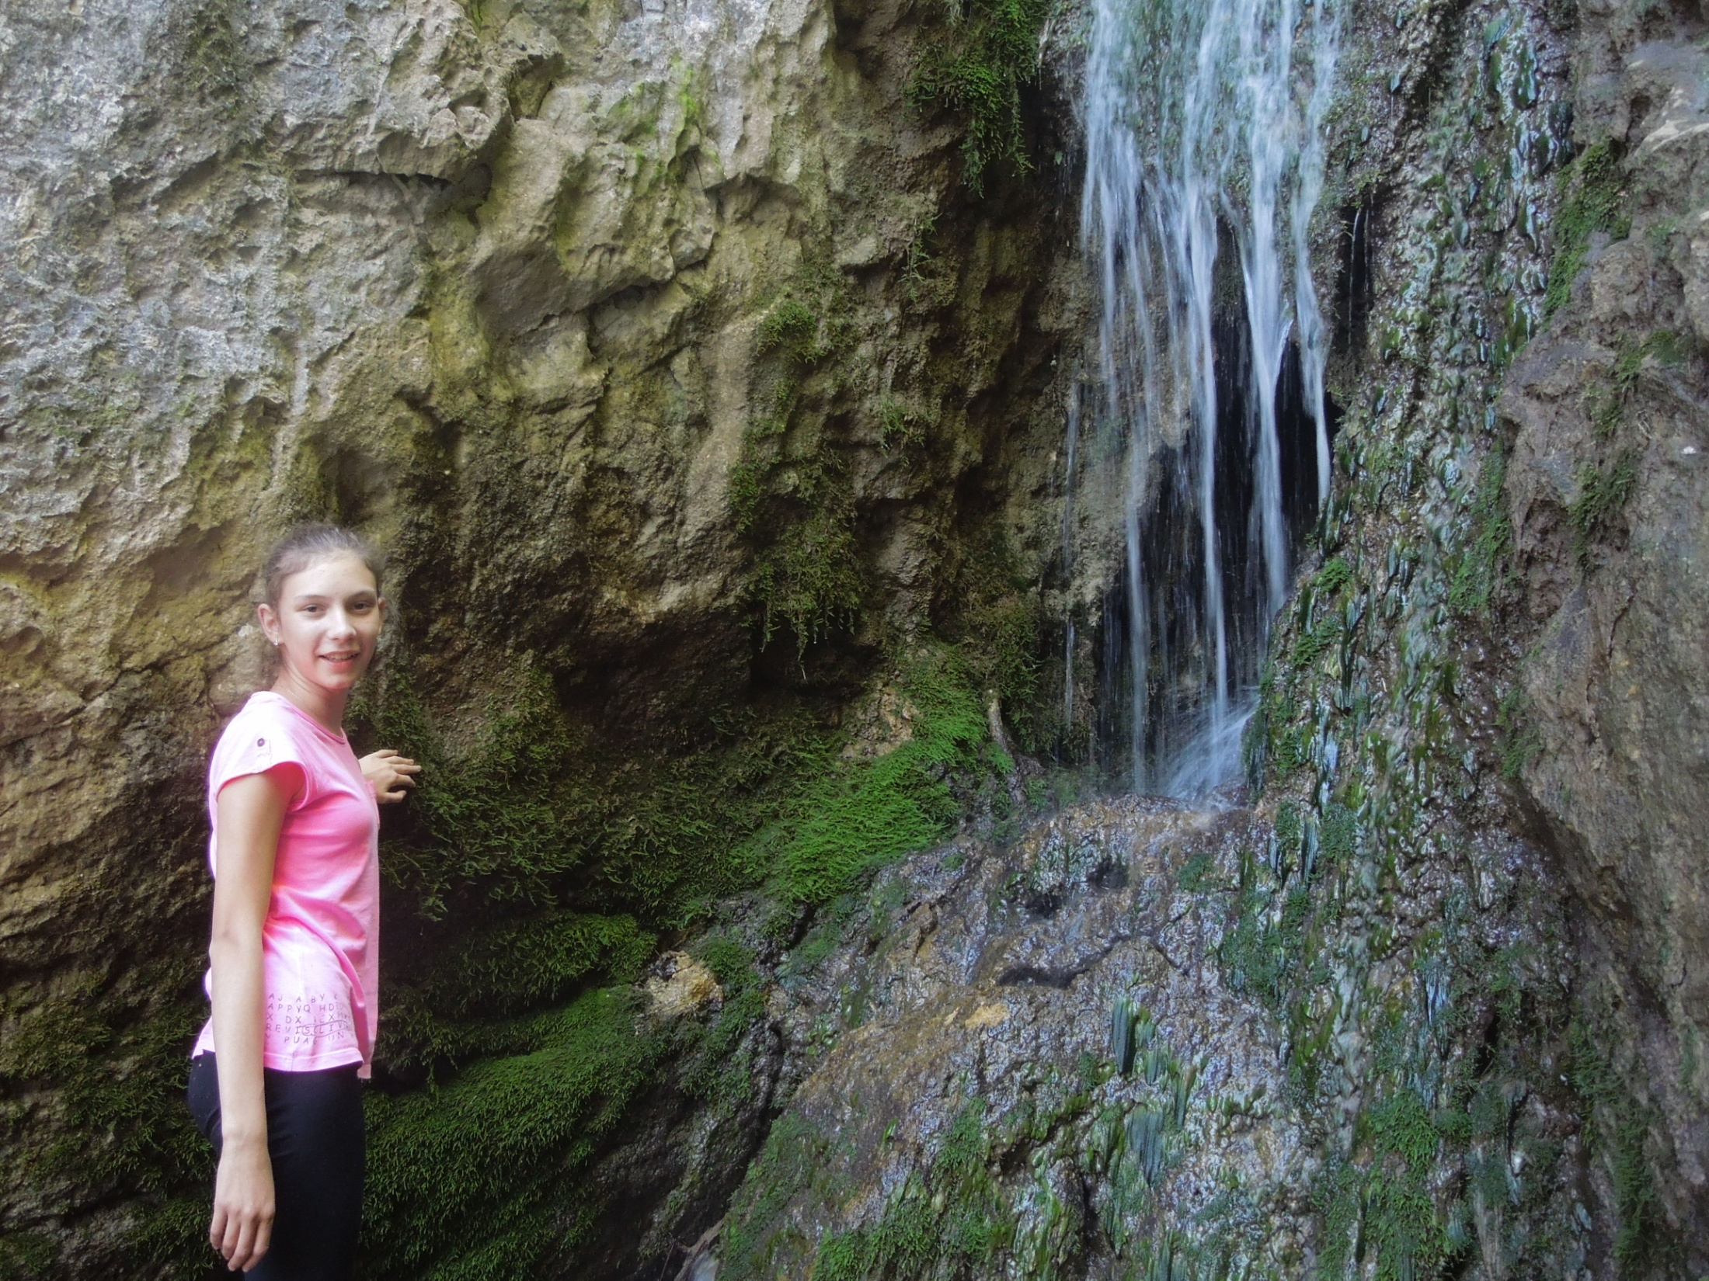
MY SISTER
She is tall.
She has got long brown hair.
She has got brown eyes.
She is 13 years old.
Her name is Edita.
Her favourite colours are red, pink, green.
Her hobbies are sewing on sewing machine, reading books and drawing.

Slide 6
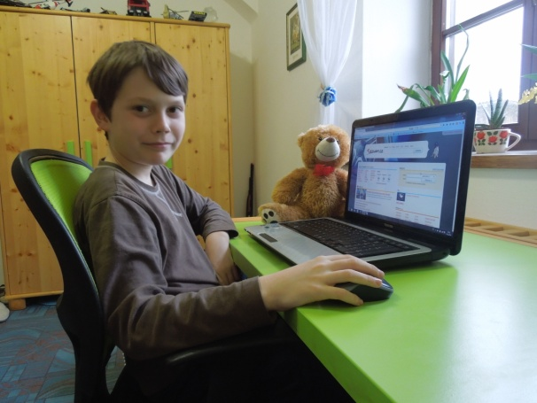
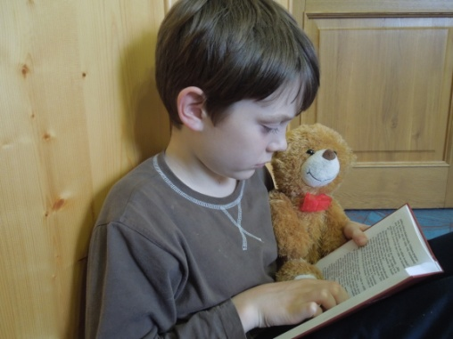
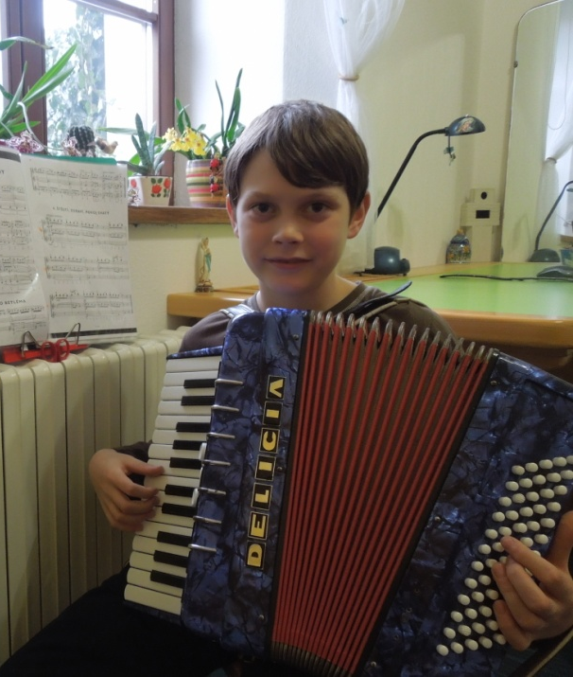
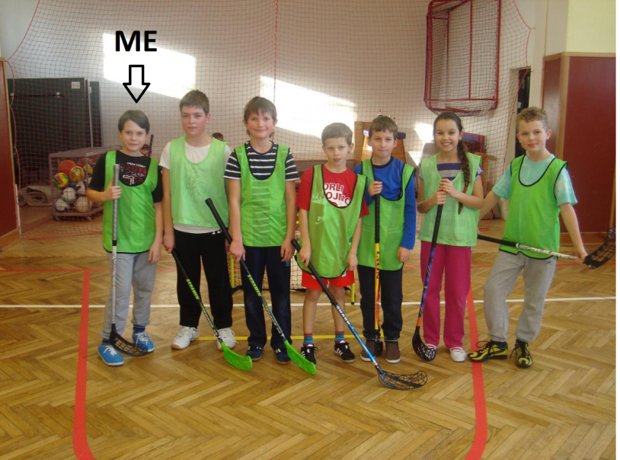
MY HOBBIES
My hobbies are playing the accordeon, playing floorball, playing computer and reading books.

Slide 7
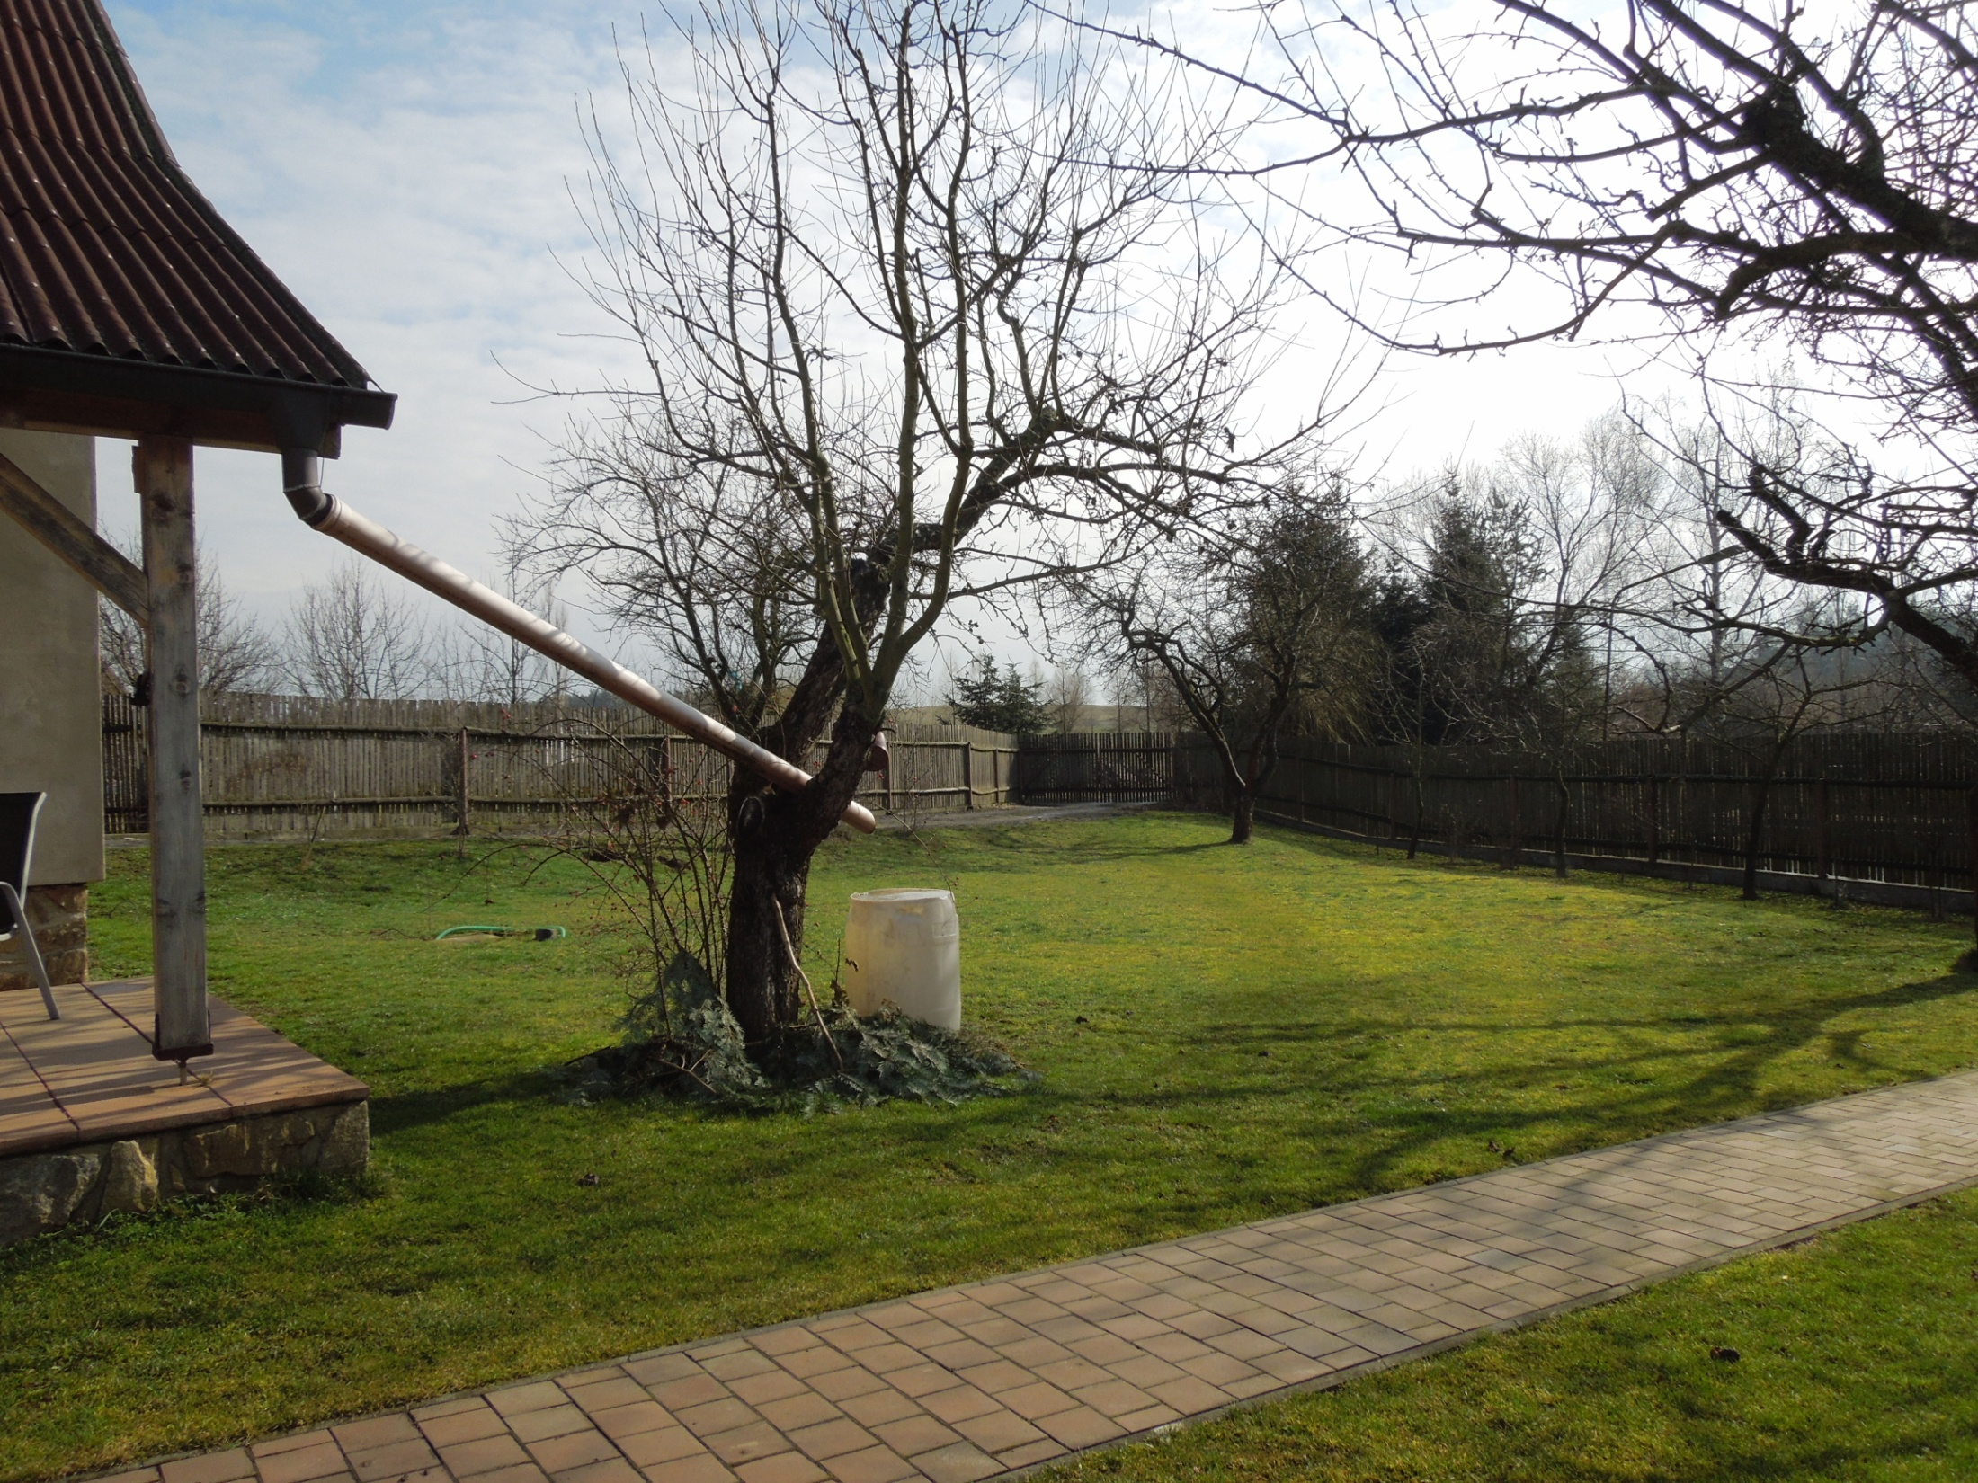
MY GARDEN

Slide 8
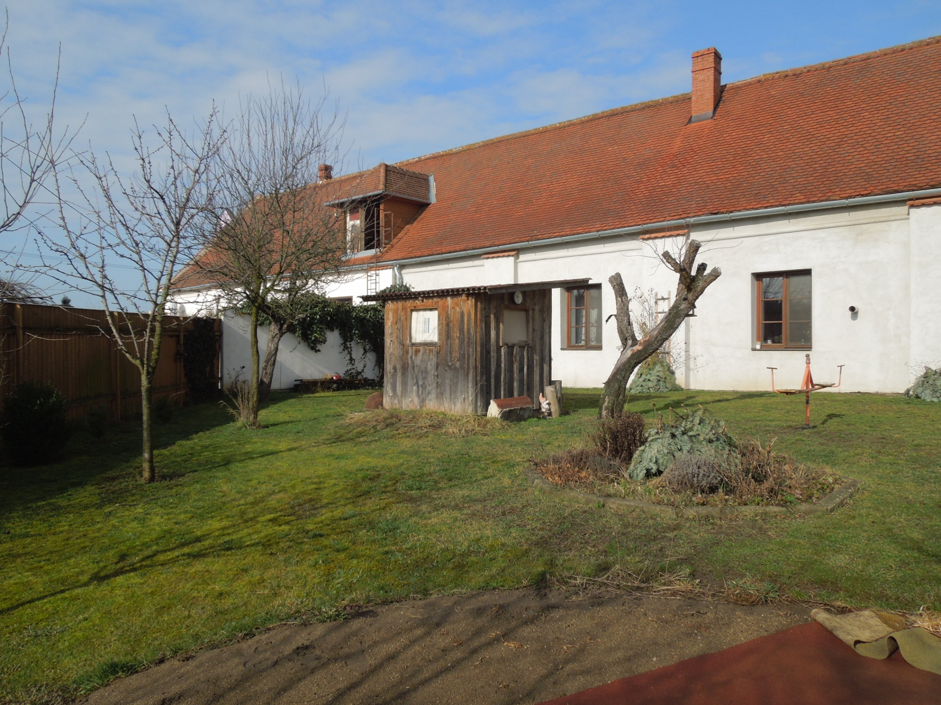
MY HOUSE

Slide 9
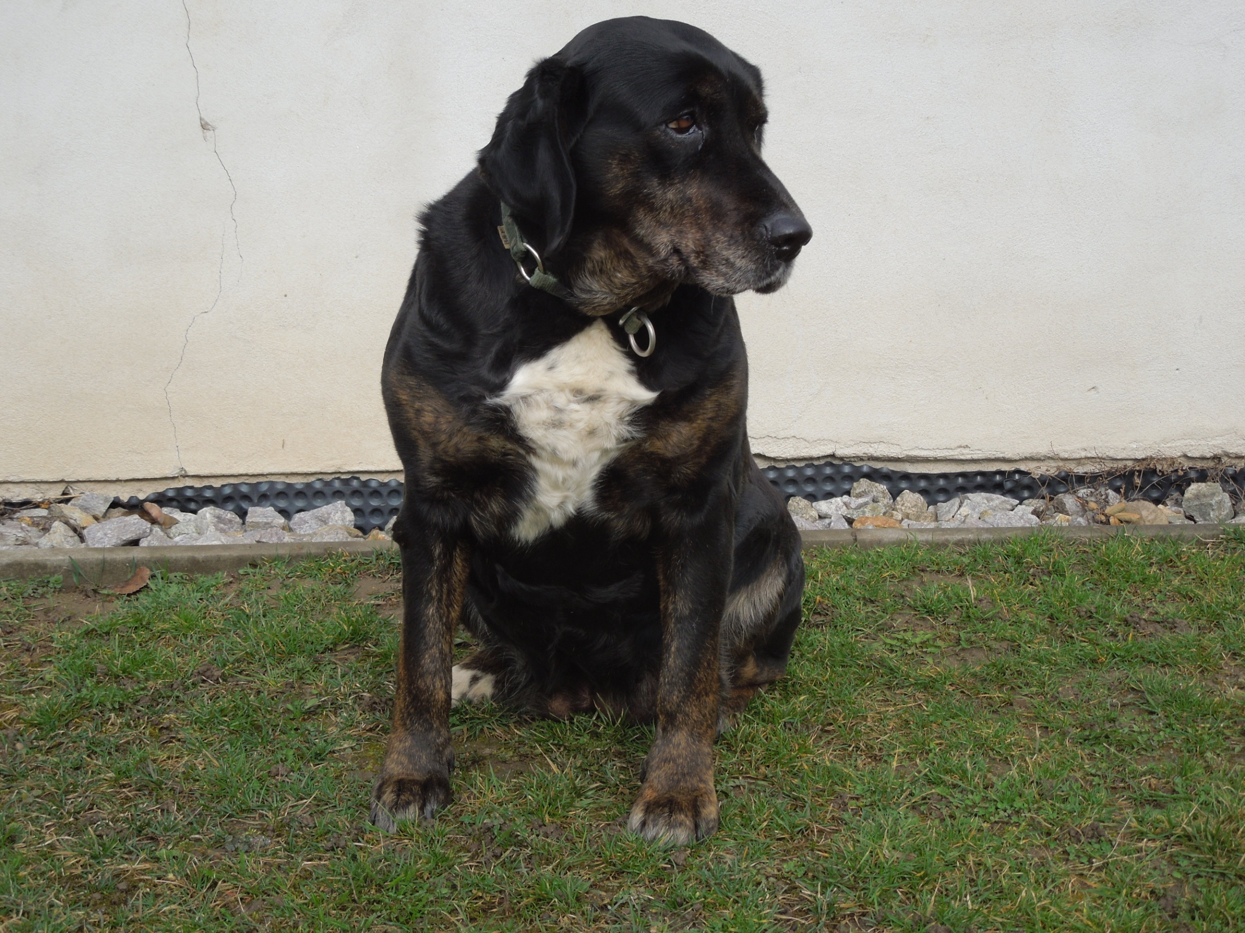
MY PET
My pet is Bára.
She is 10 years old.
She is black and white.

Slide 10
BYE BYE

