Slide 1
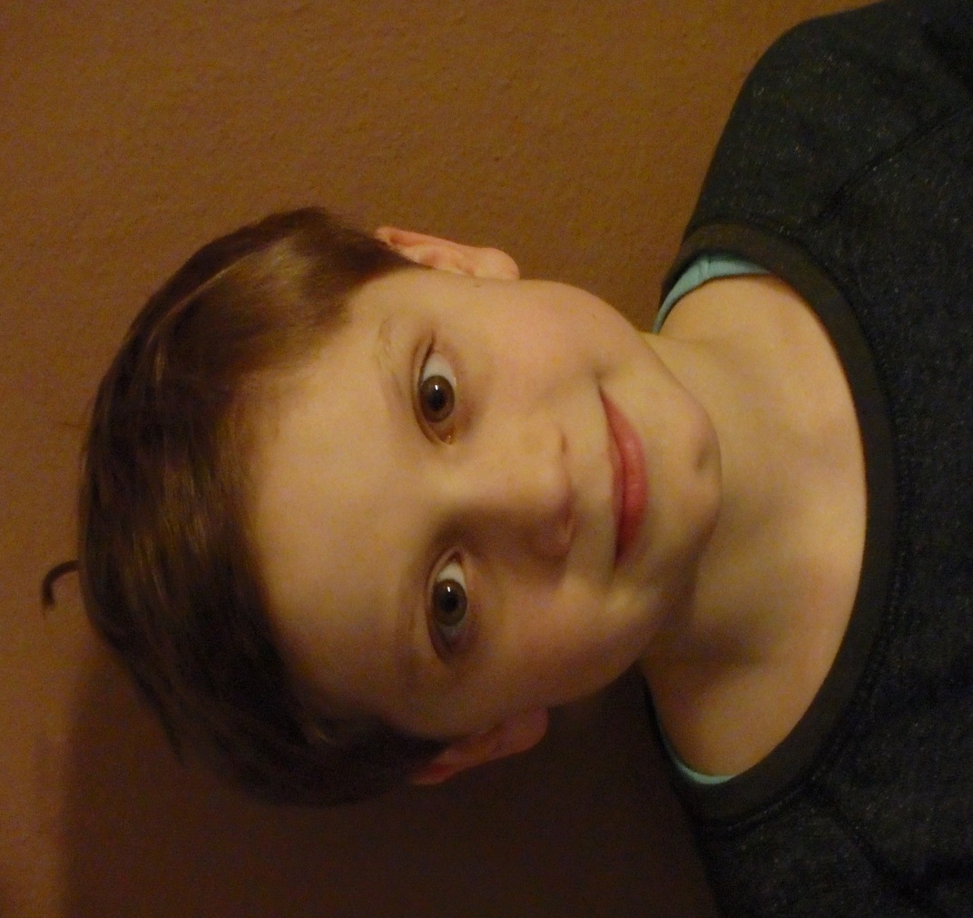
My name is Jakub Kovářík. I´m 11 years old.

Slide 2
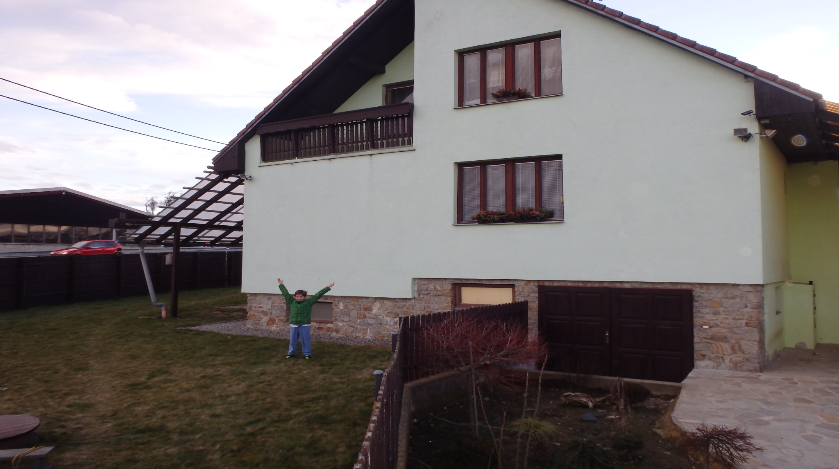
I live in village Pavlice.

Slide 3
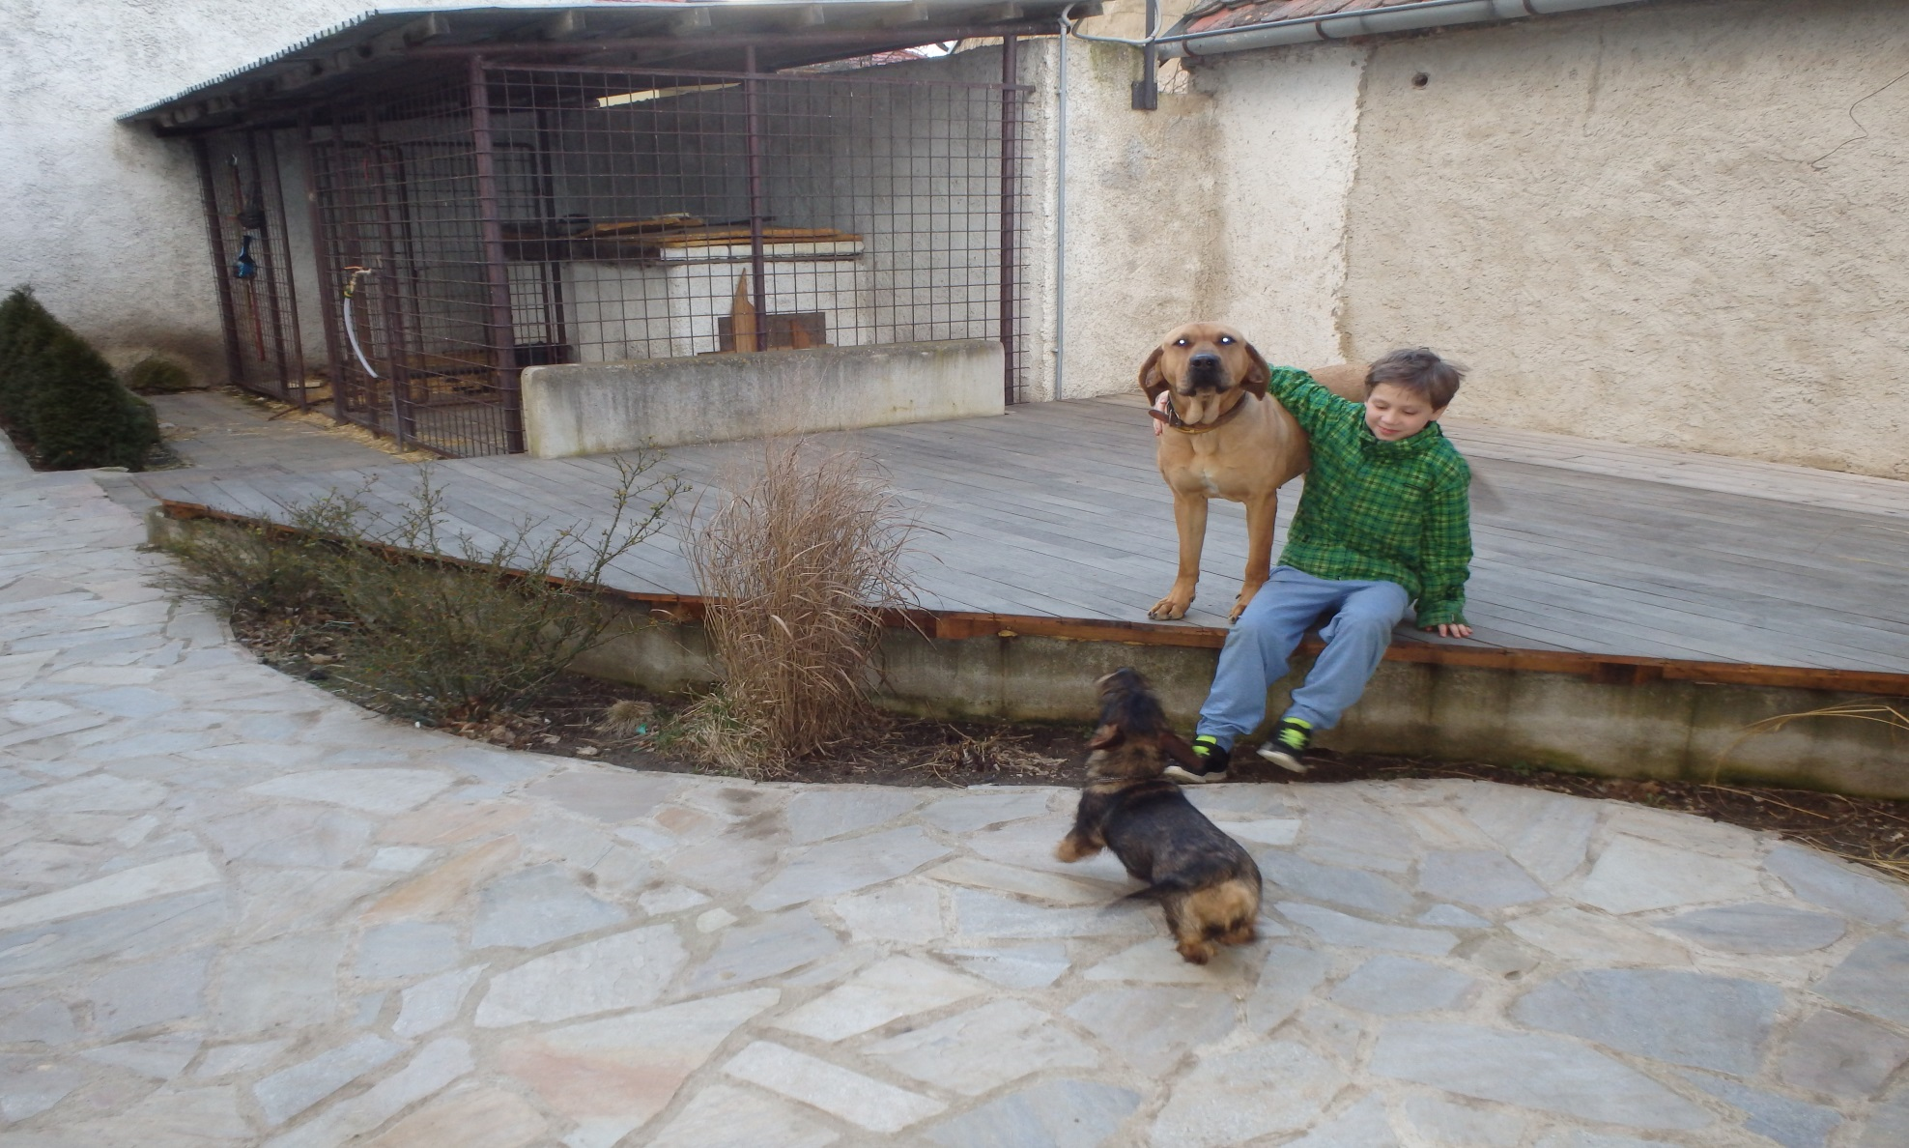
I like our dogs Viki and Rida.

Slide 4
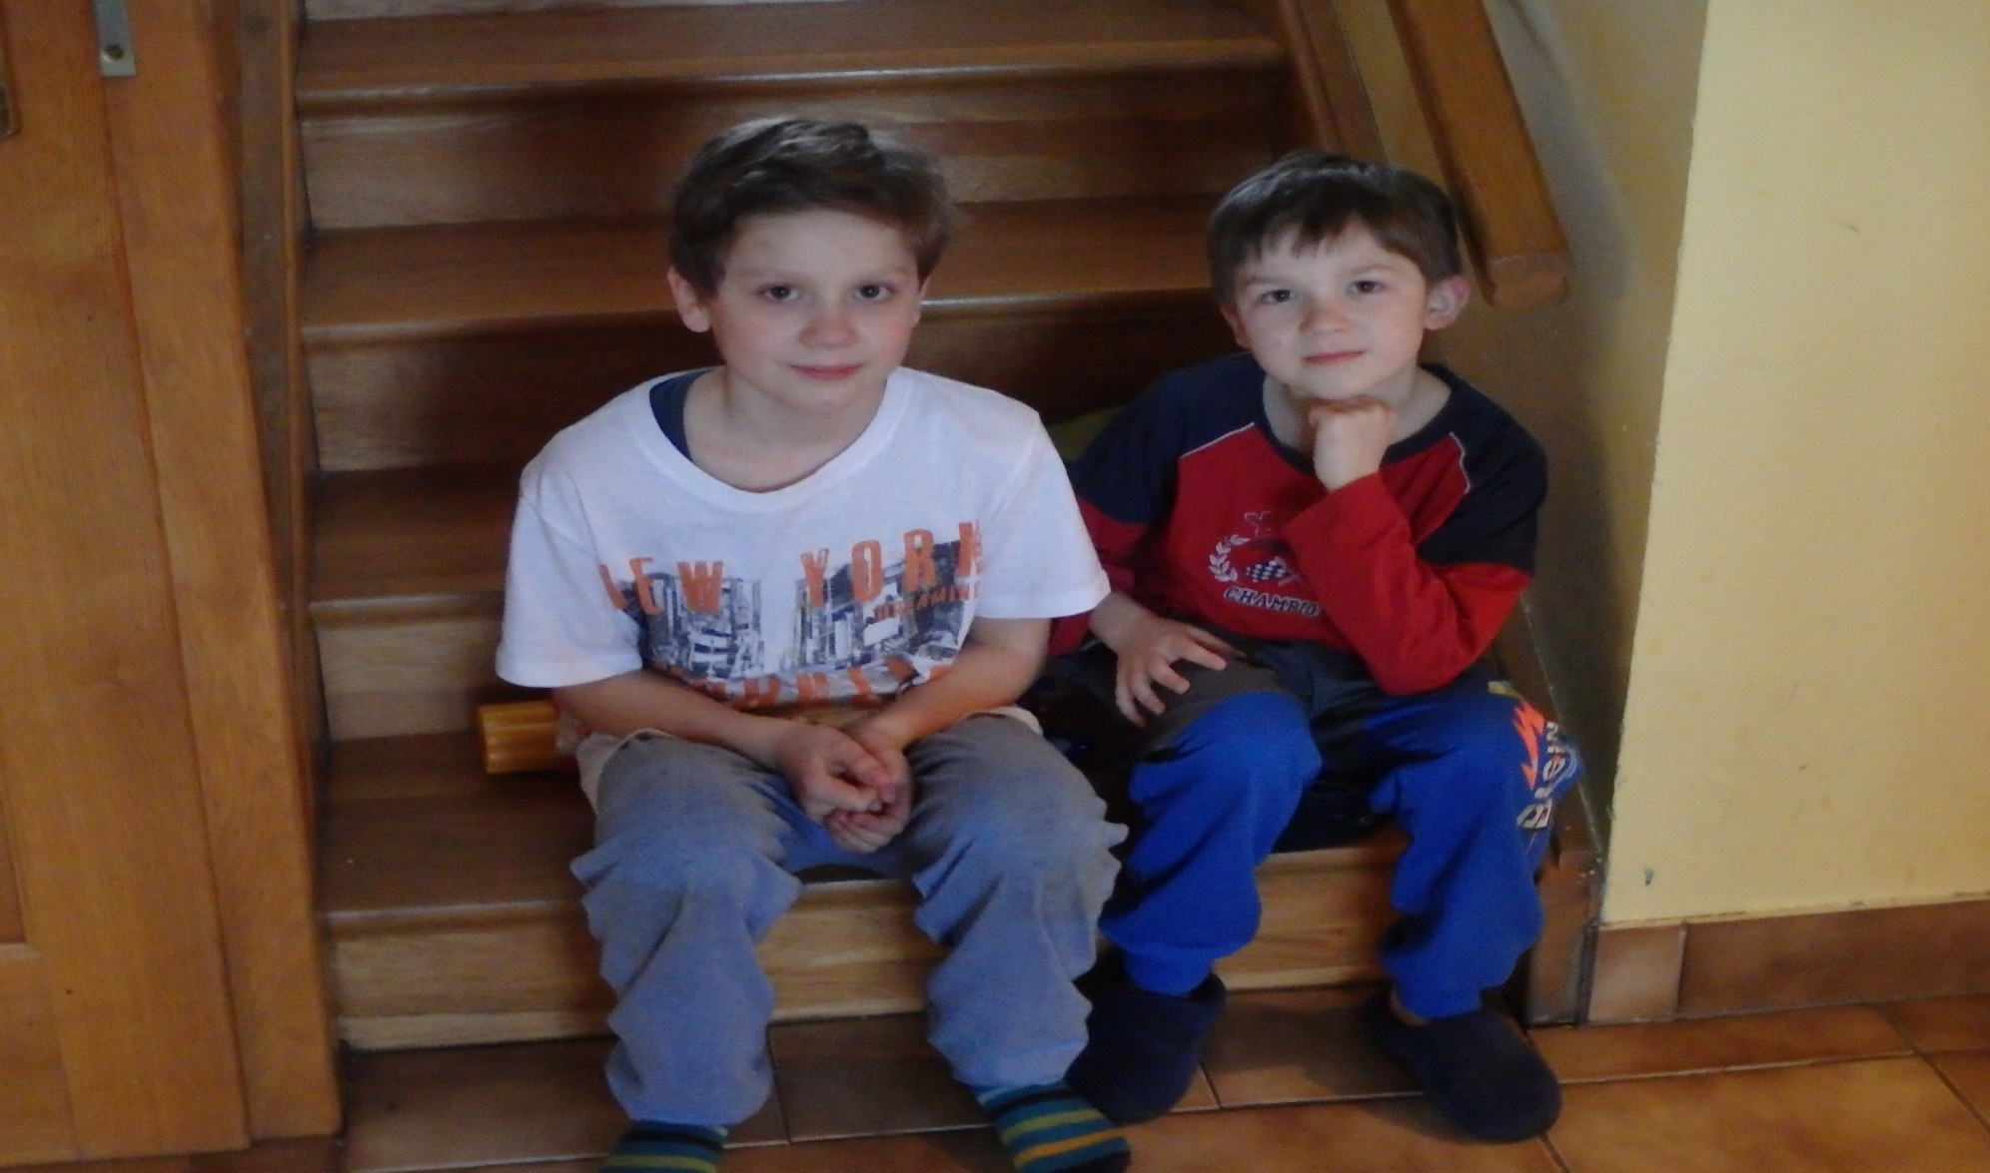
This is my brother Martin.

Slide 5
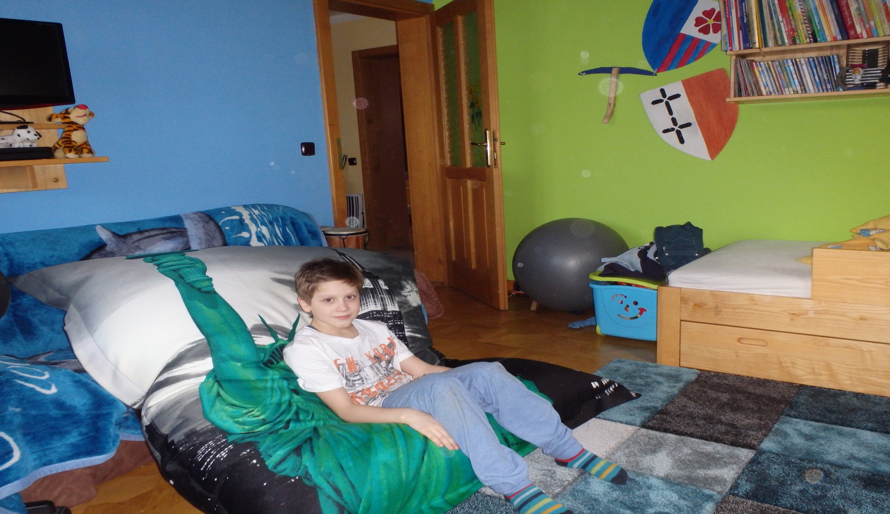
This is my and brother‘s bedroom.

Slide 6
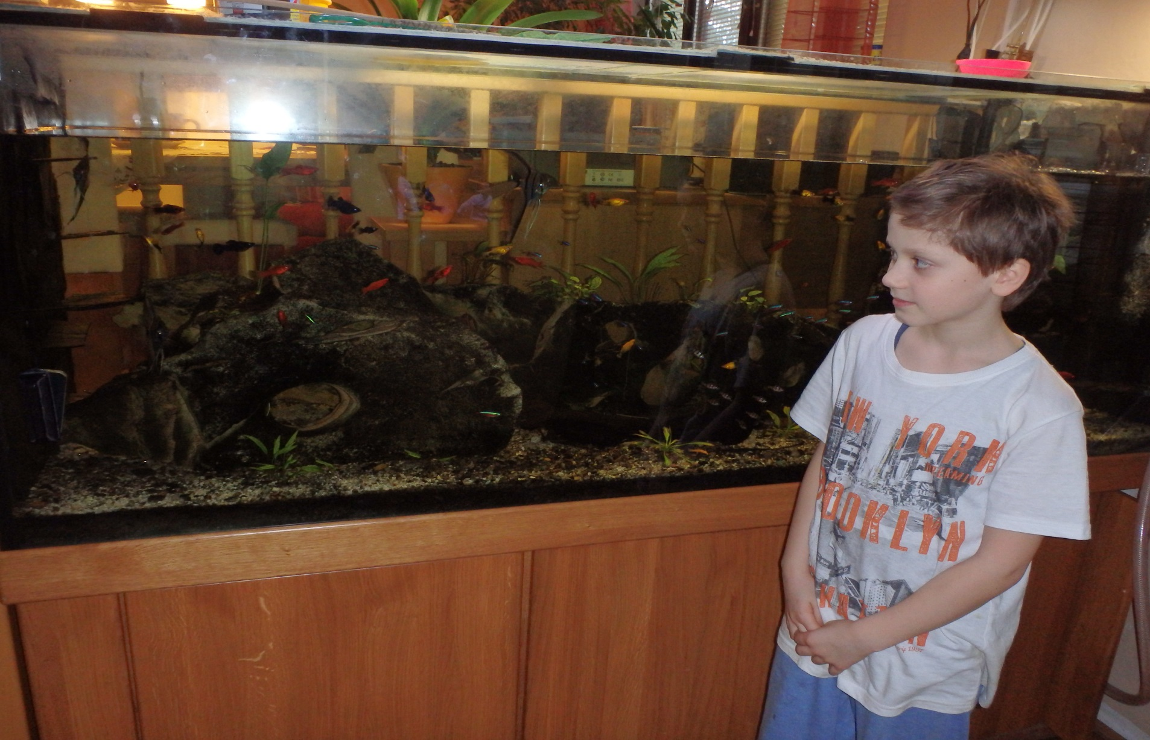
We have got the aquarium in the livingroom.

