Slide 1
Elena Jarošová

Slide 2
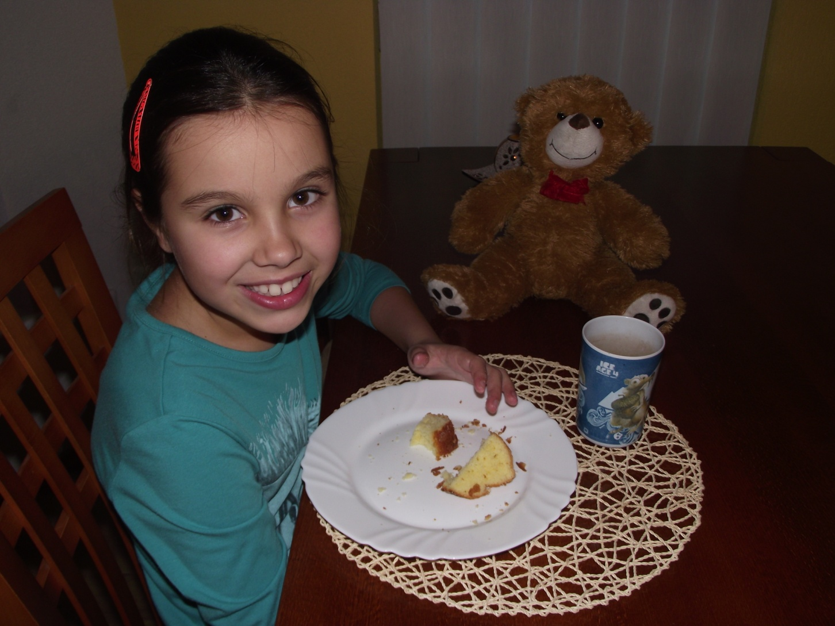
I have a breakfast.

Slide 3
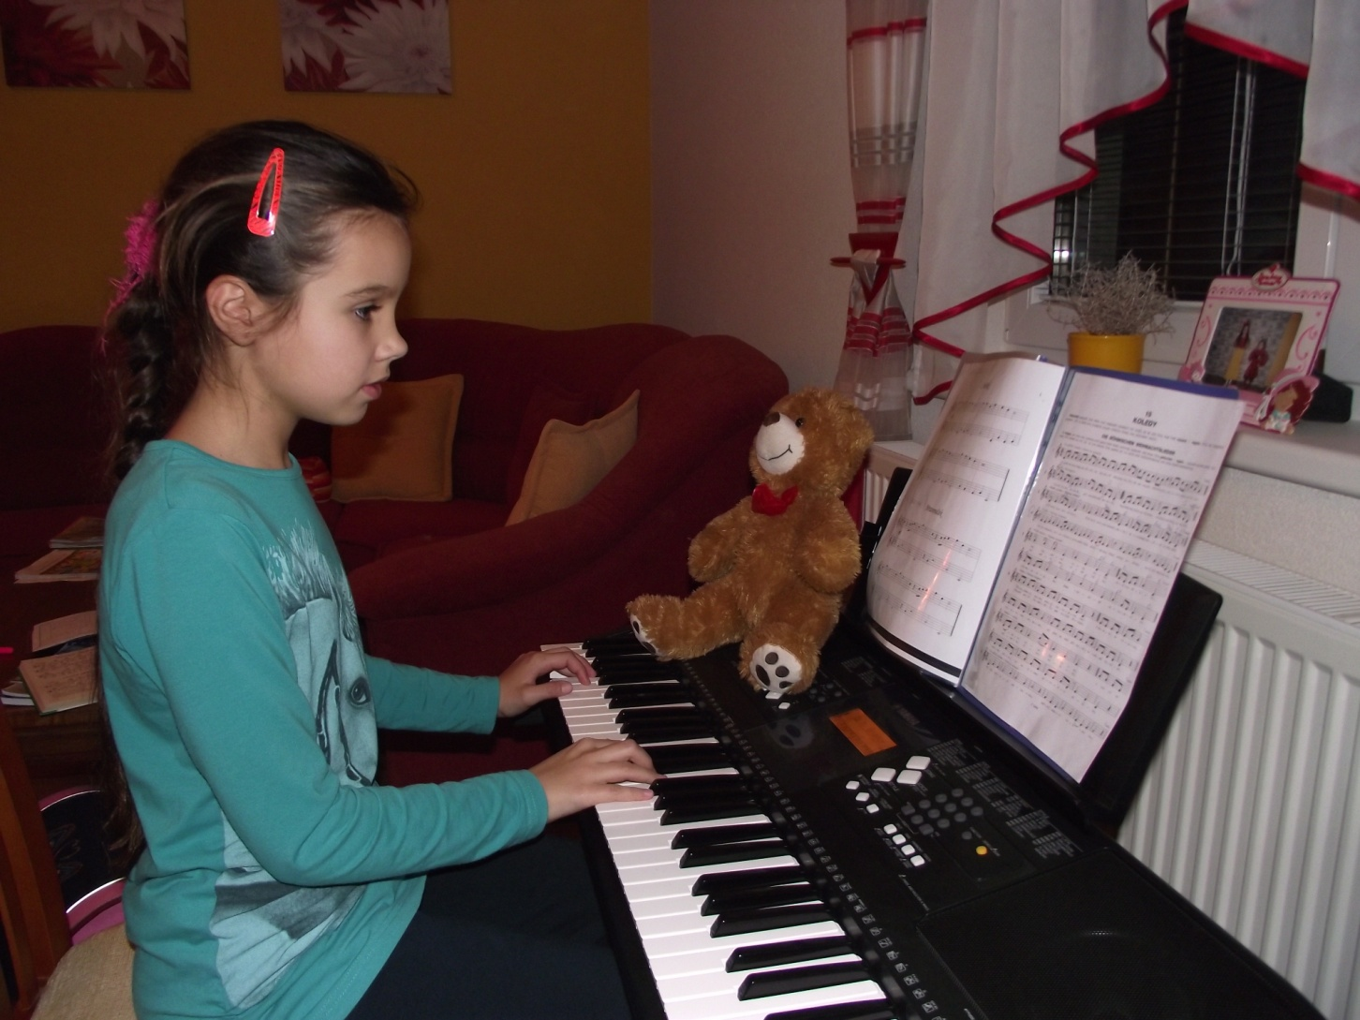
I´m playing the piano.

Slide 4
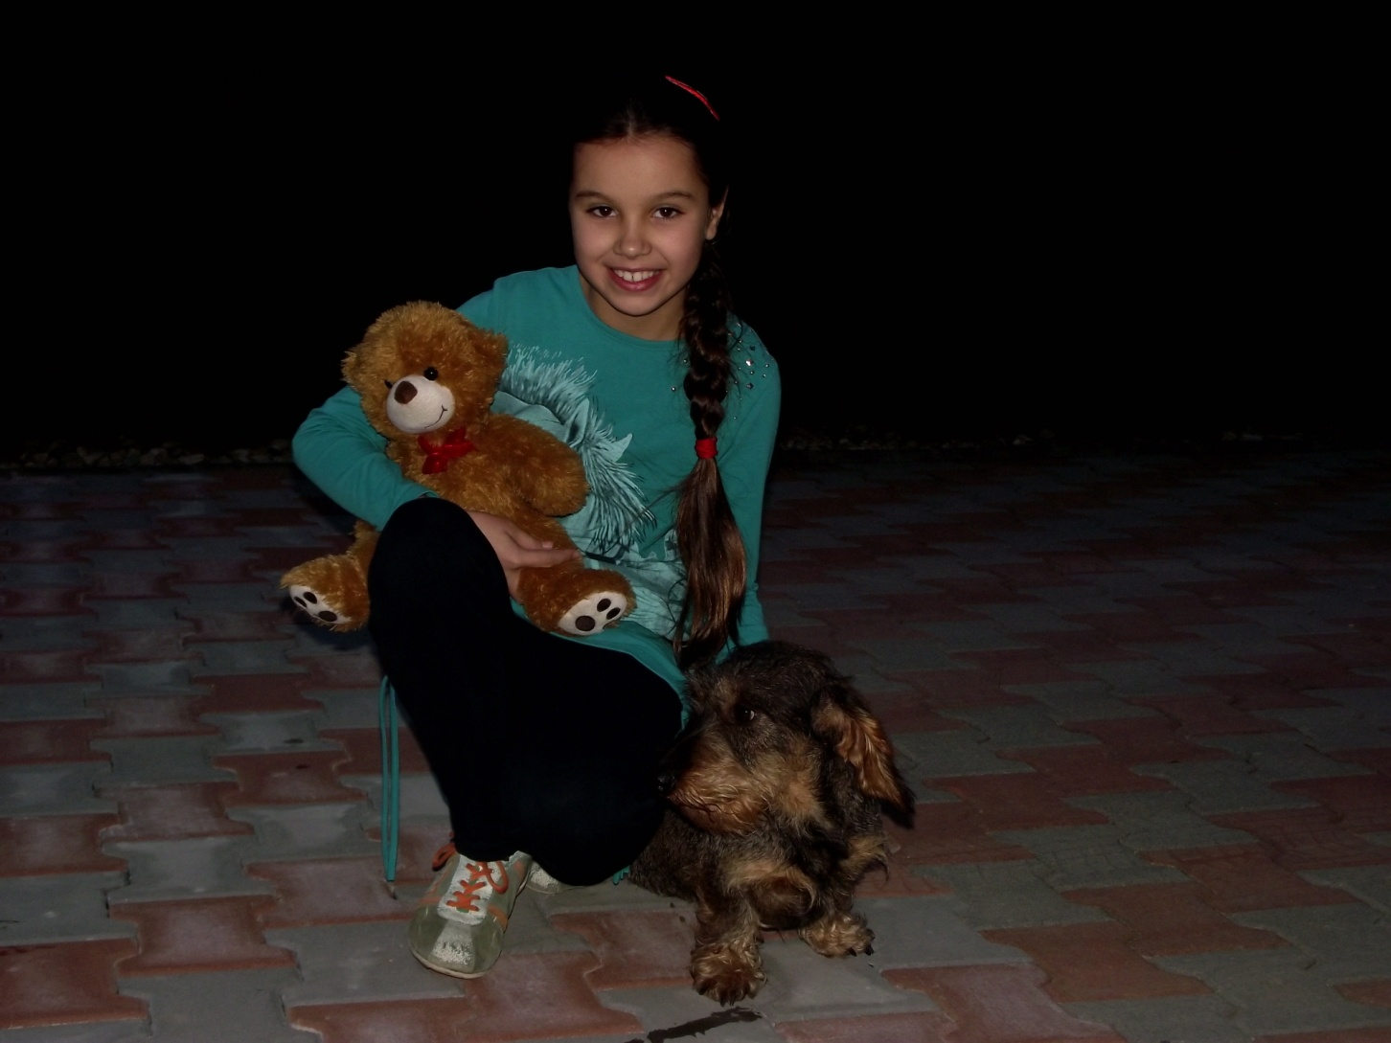
This is my dog.

Slide 5
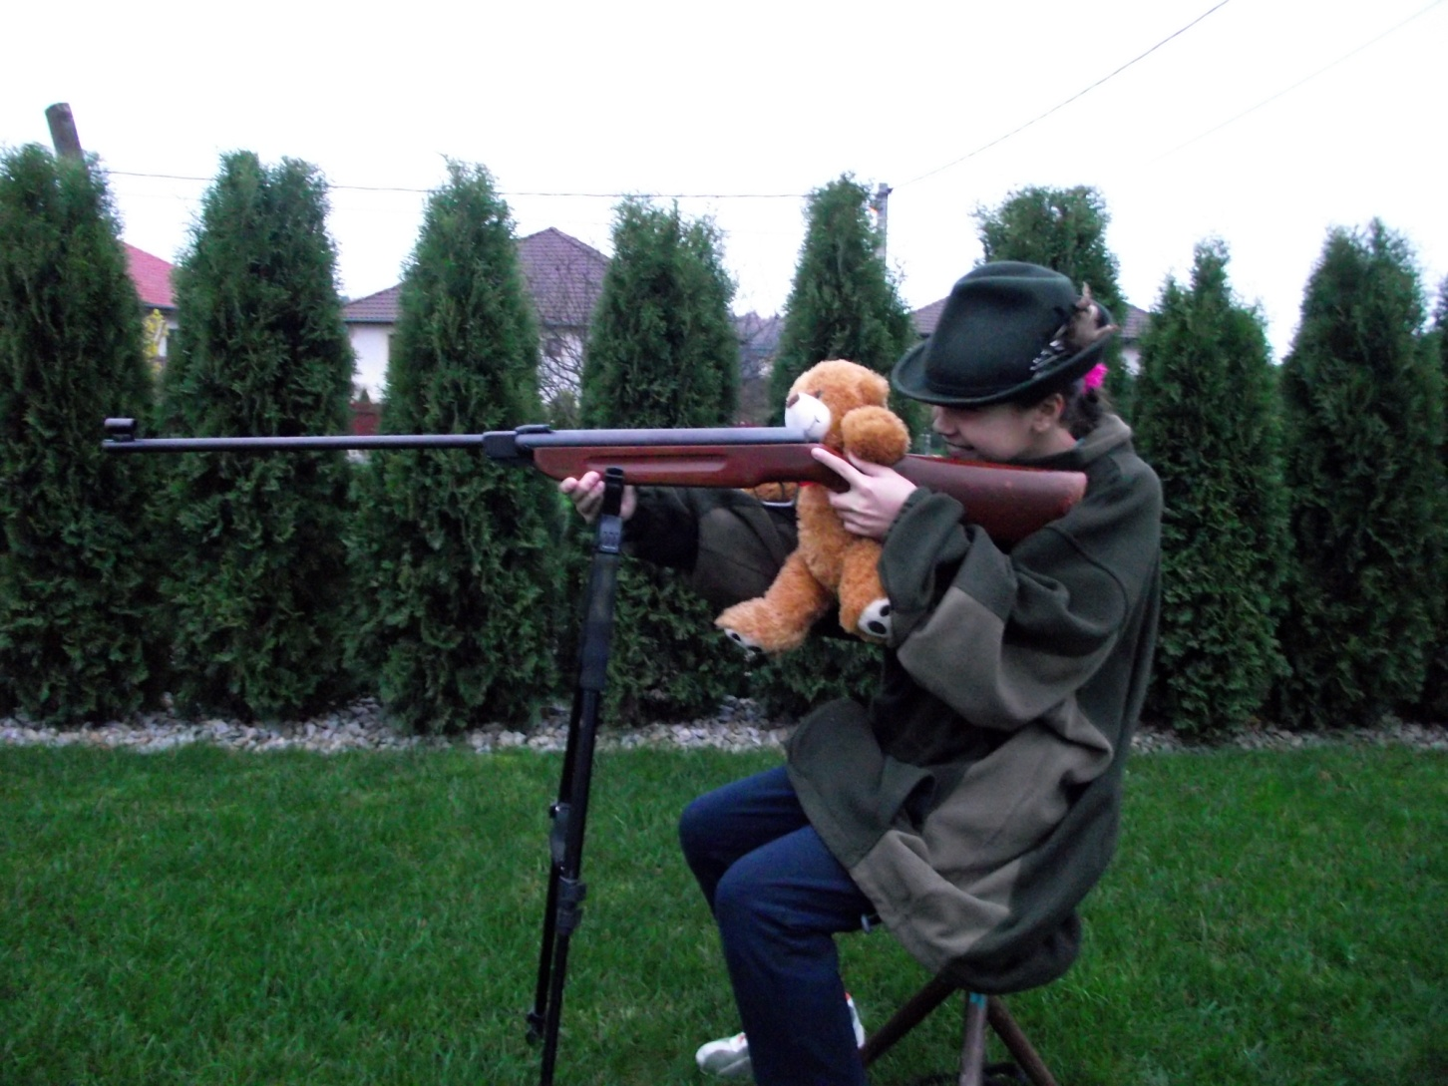
I´m a hunter.

Slide 6
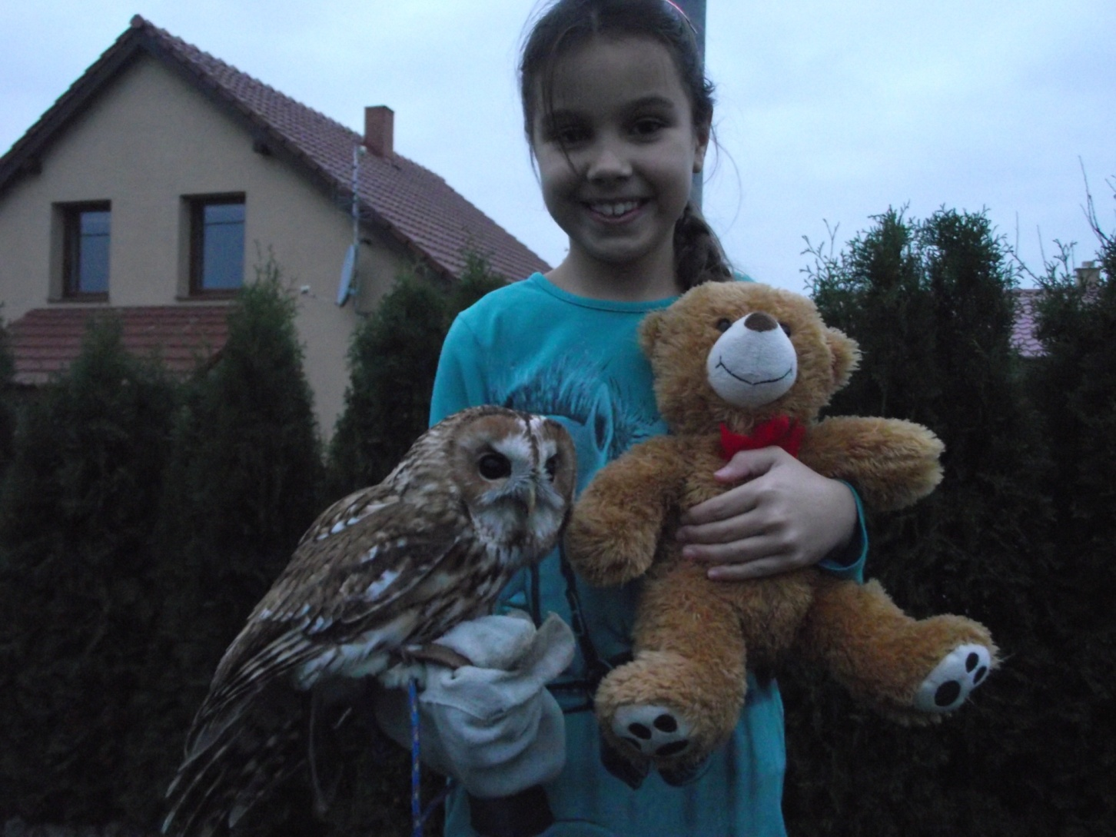
This is our owl.

