Slide 1
Richard Částek

Slide 2
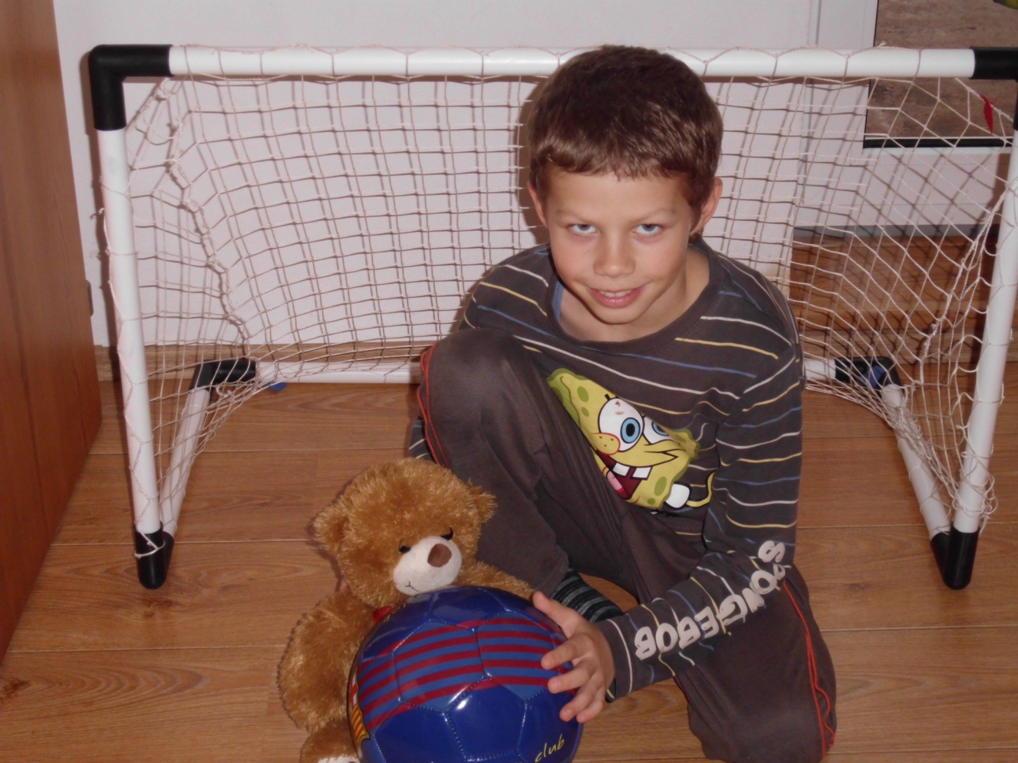
I´m playing with the ball.

Slide 3
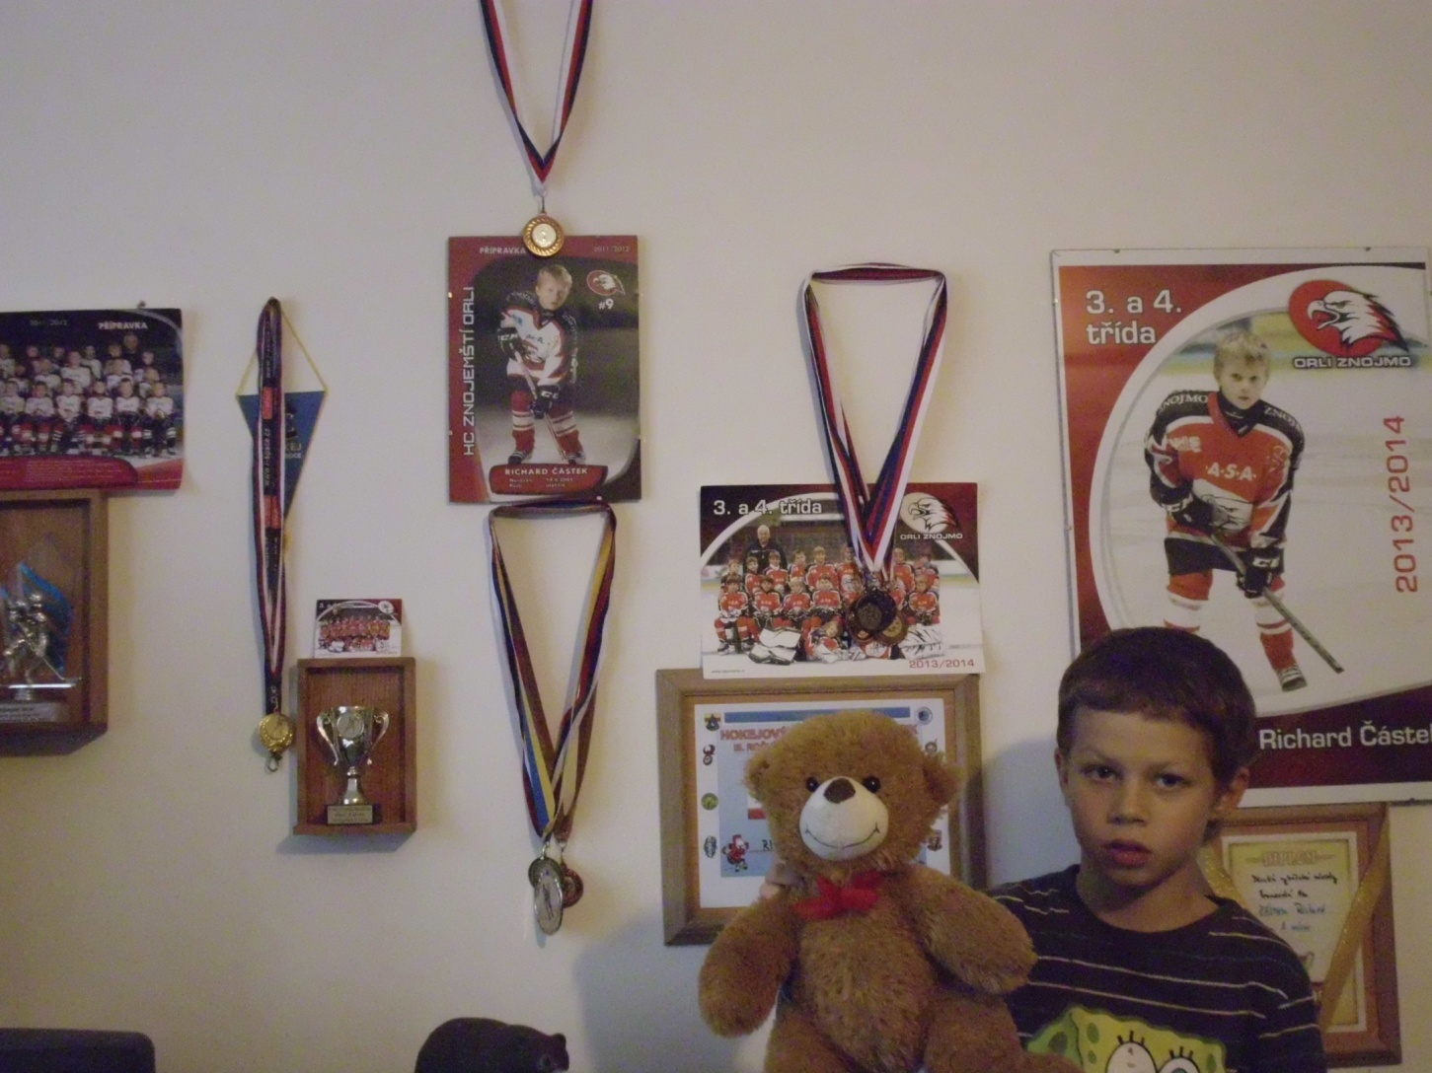
These are my medals and cups

Slide 4
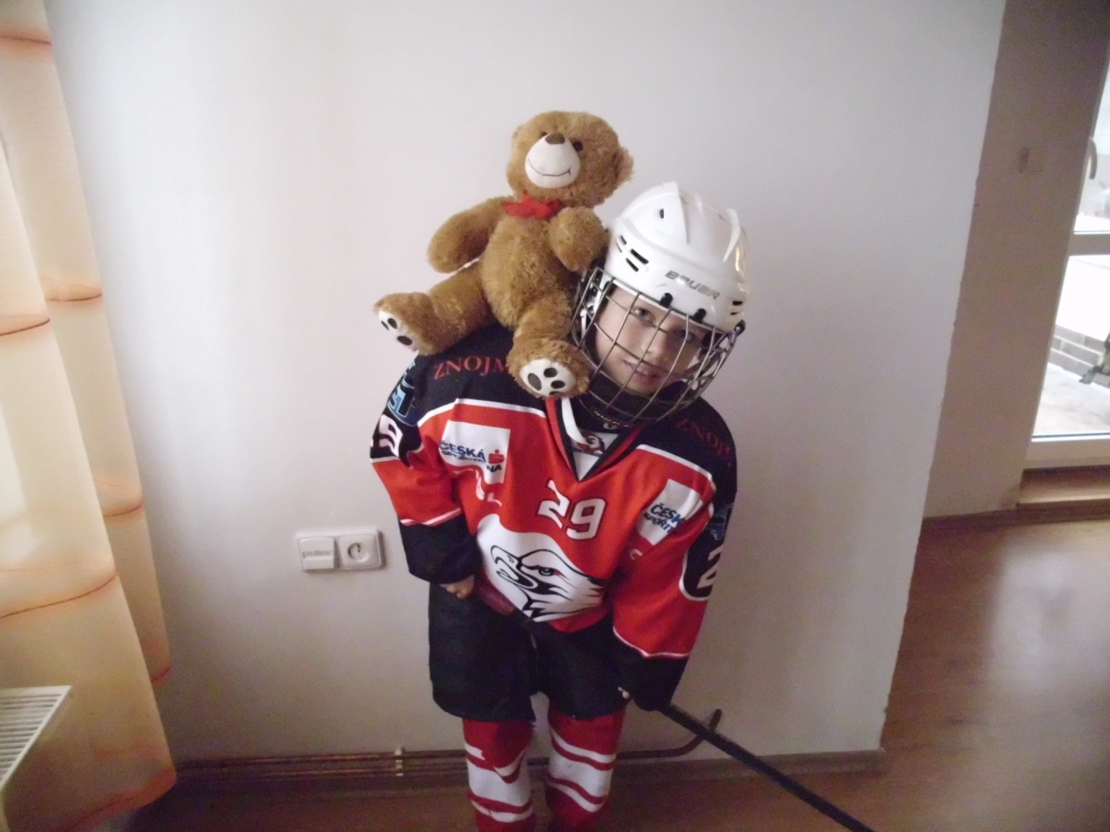
Hockey is my favourite sport.

Slide 5
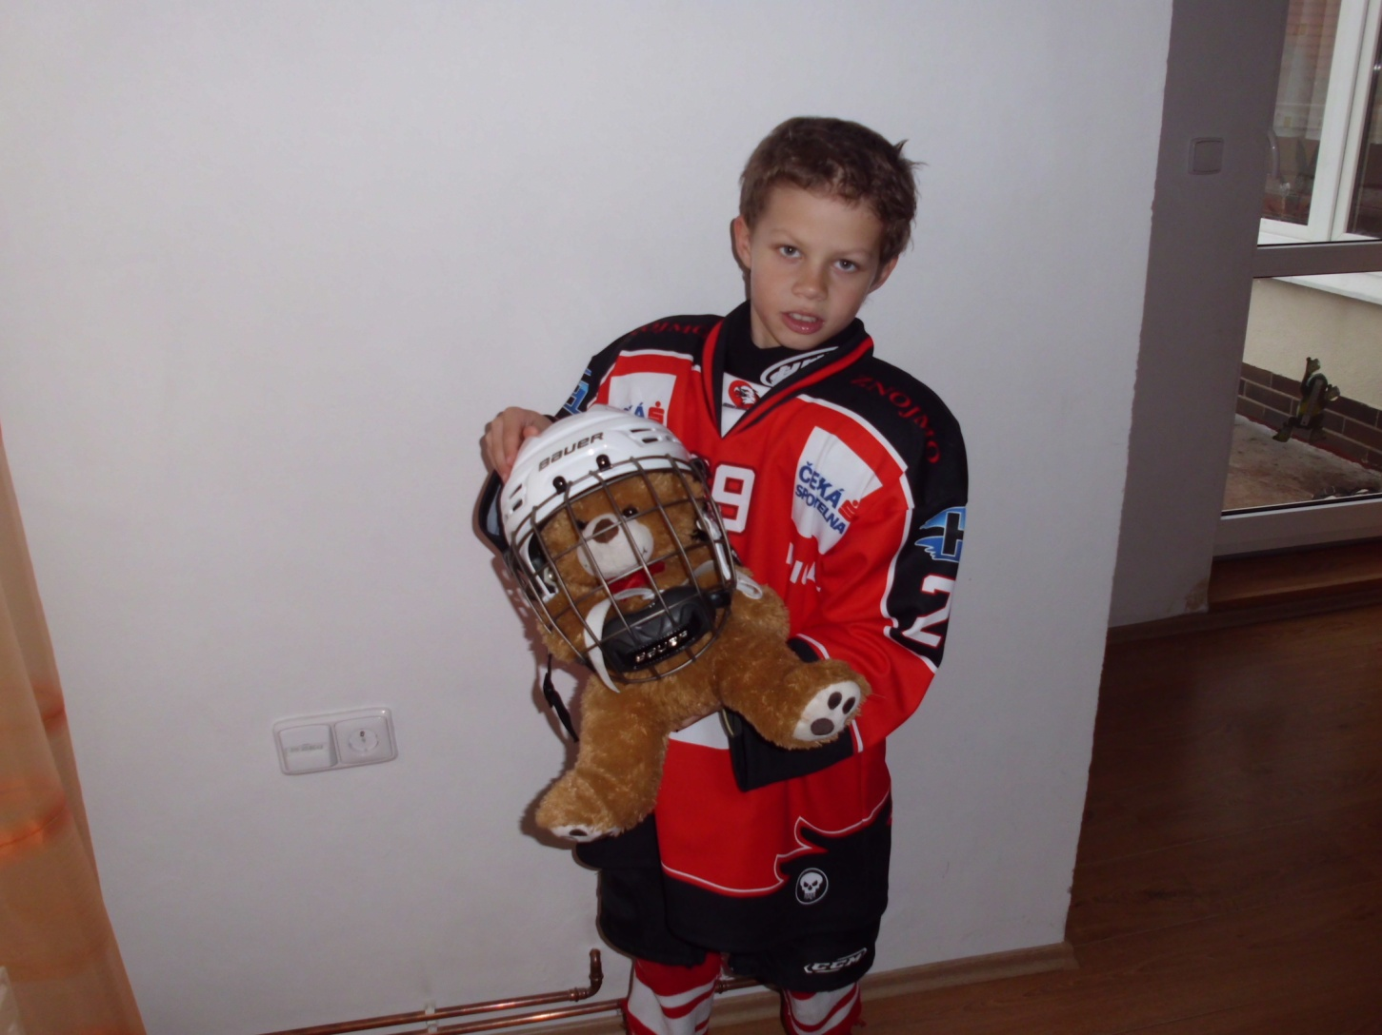
I´m good at playing hockey.

Slide 6
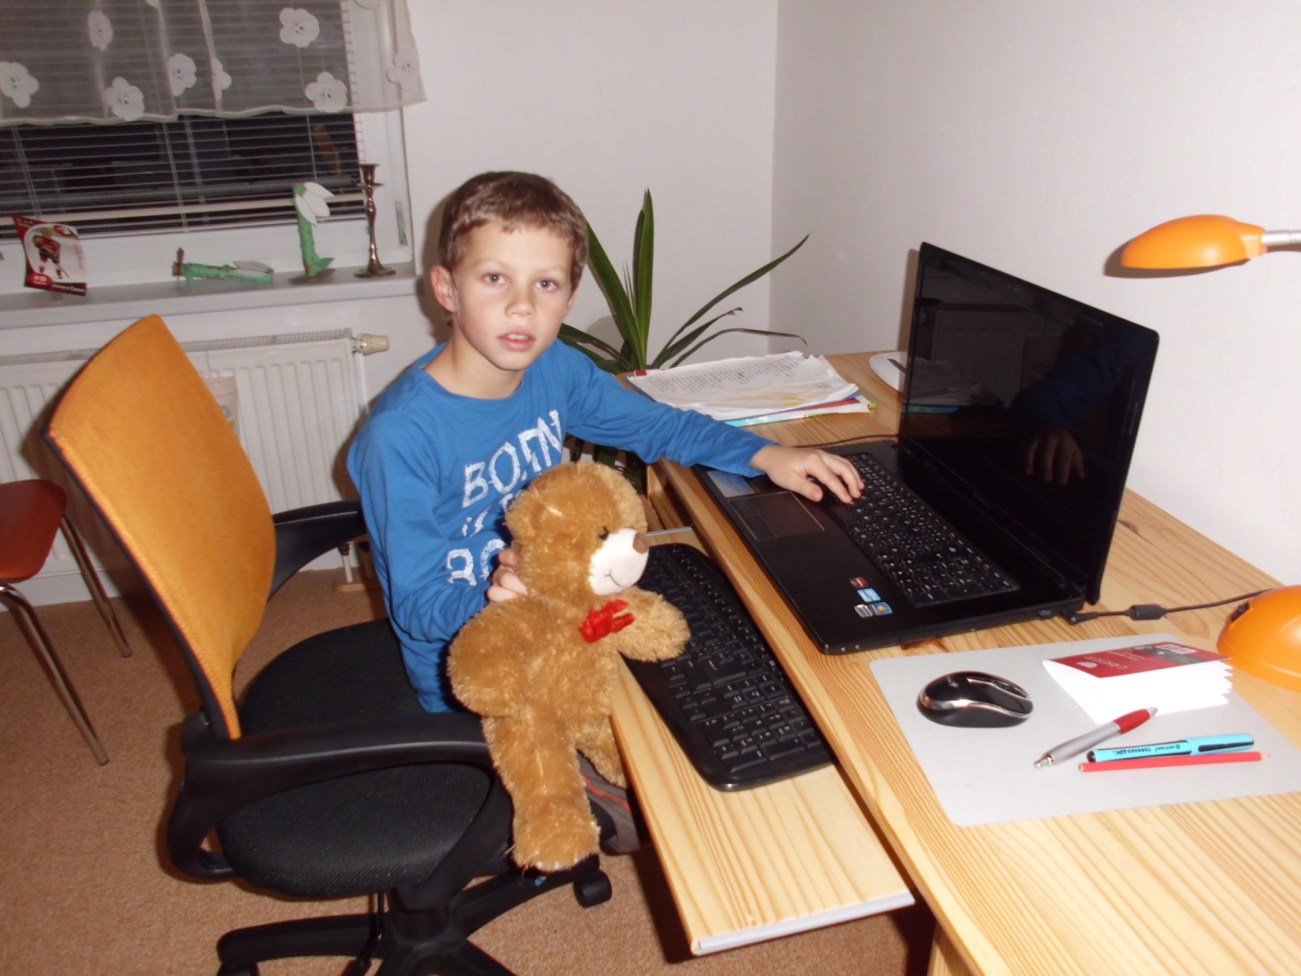
This is my computer.

