Slide 1
Natálie Brabencová

Slide 2
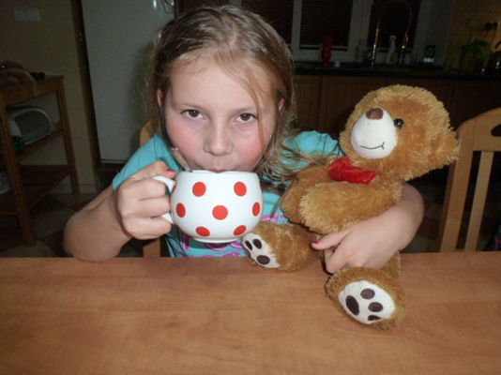
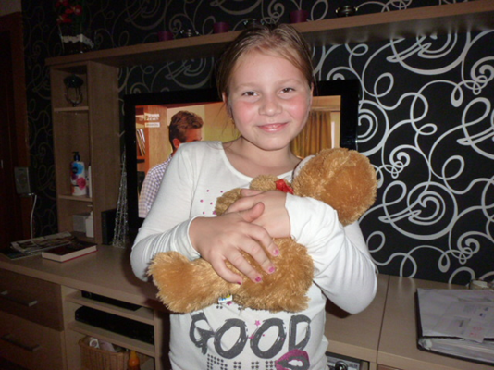
Breakfast in the kitchen.

Slide 3
I´m going to the school.

Slide 4
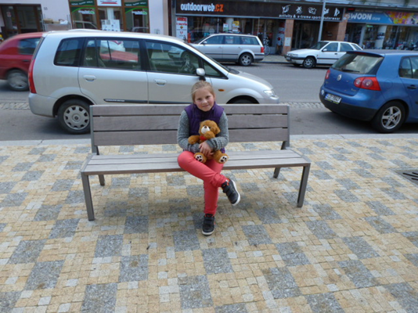
I´m going shopping.

Slide 5
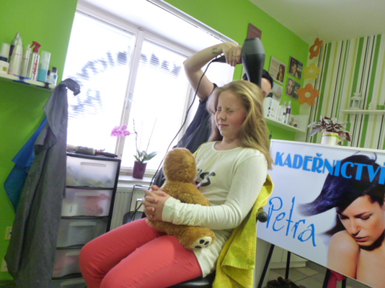
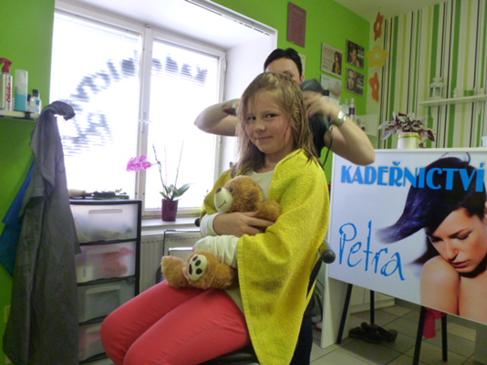
The hairdresser is cutting my hair.

Slide 6
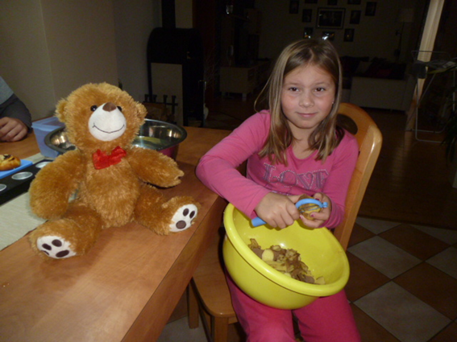
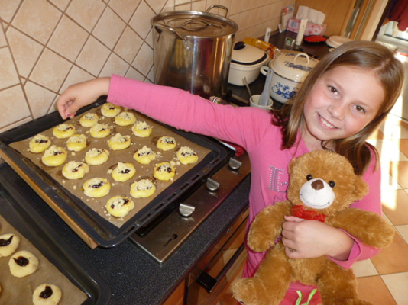
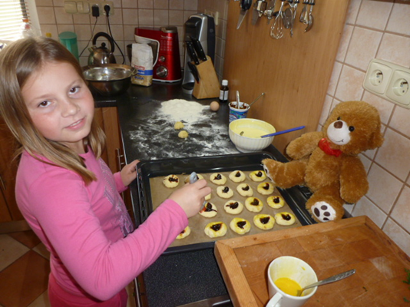
I´m helping my mum.

Slide 7
I´m cleaning the house.

Slide 8
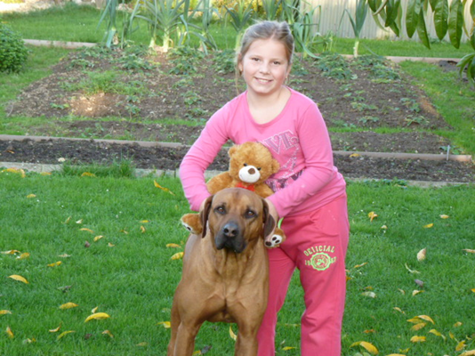
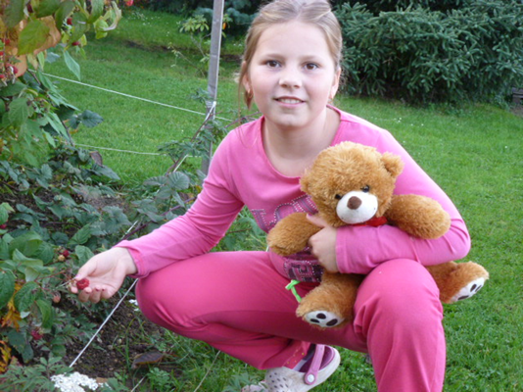
In the garden with my dog.

Slide 9
Bed linen is dry.

Slide 10
I´m playing piano.

Slide 11
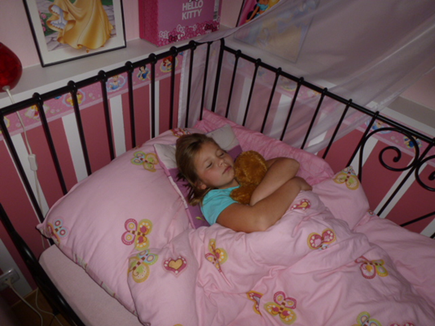
I´m sleeping in my pink bed.

