Slide 1
Karolína Nachtenblová

Slide 2
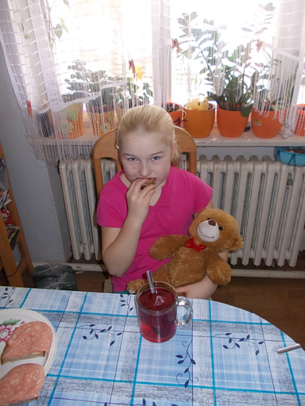
I´m drinking and eating.

Slide 3
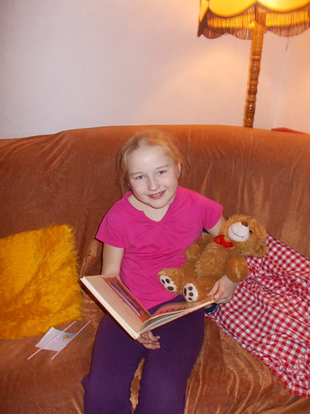
I´m reading in our sittingroom.

Slide 4
I´m sitting in the car. I like cars.

