Slide 1
Dominik William Perry

Slide 2
I´m in our livingroom

Slide 3
I´m doing my homework.

Slide 4
I´m playing the guitar.

Slide 5
I´m reading my favourite book.

Slide 6
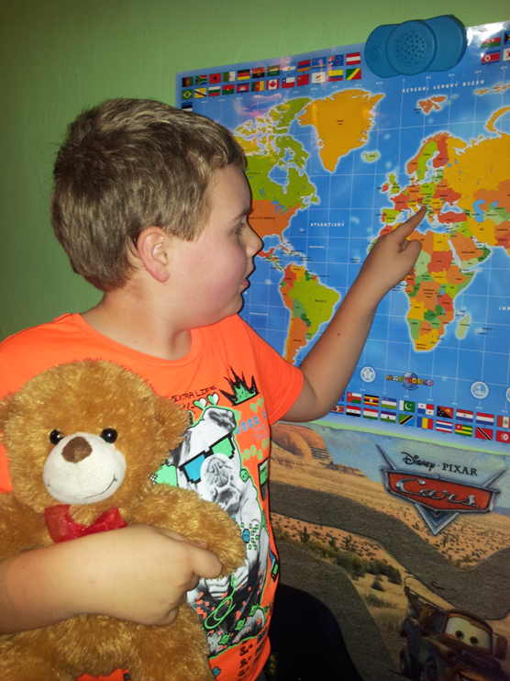
I like geography.

Slide 7
I´m playing with my toys.

Slide 8
I´m sleeping in my bed.

